Slide 1
Syllabus
IoT Paper reading
Quiz (20%) => 沒考一律0分沒有請假補考
Term project report with implementation (Python and github open source)
Phase I (20%) => 9月底
Phase II (20%) => 10月中
Phase III (20%) => 12月初
Final exam. (20%)
上課不定期點名, 沒有補點與請假, 缺課3次以上一律出席狀況不佳扣考, 直接結算當下成績。

Slide 2
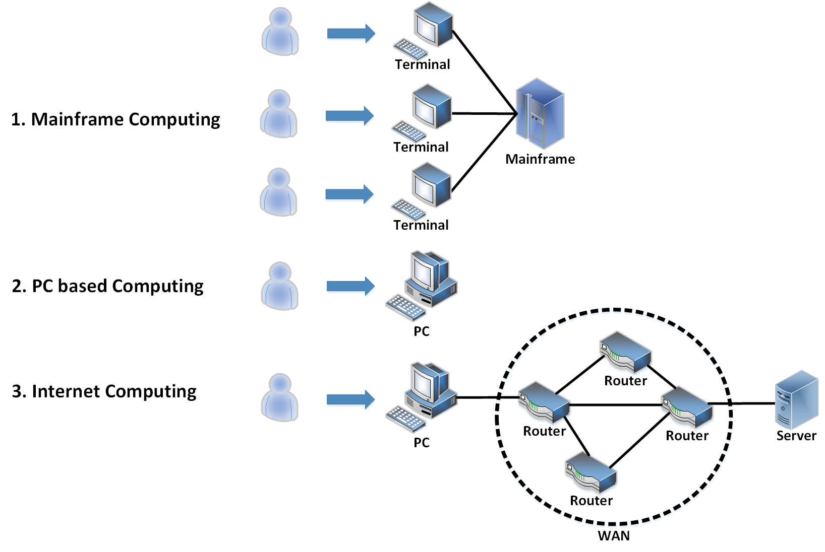
Computing Evolution

Slide 3
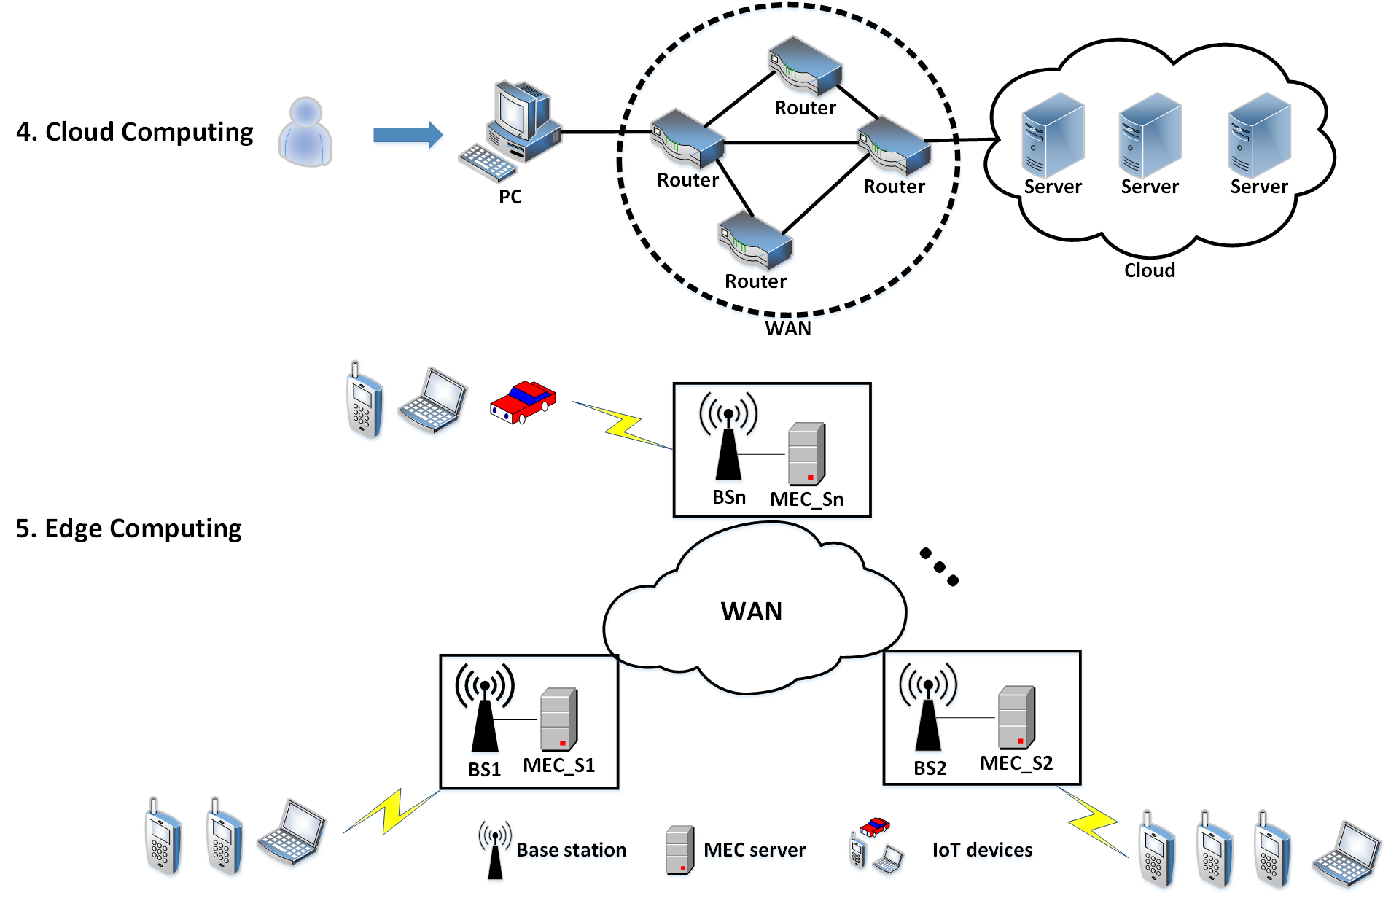
Computing Evolution

Slide 4
IoT Cloud Application Case
Internet of Things (IoT) applications have been rapidly developing in various domains such as smart city.
In the smart city application, there are many different types of IoT data (e.g. street lighting control data, city traffic data, air pollution monitoring data, etc.).
Some smart city IoT data needs to be rapidly processed for offering the real-time decision (e.g. the leaky detection of city infrastructural resources).
The cloud computing system is the general execution platform for IoT applications.

Slide 5
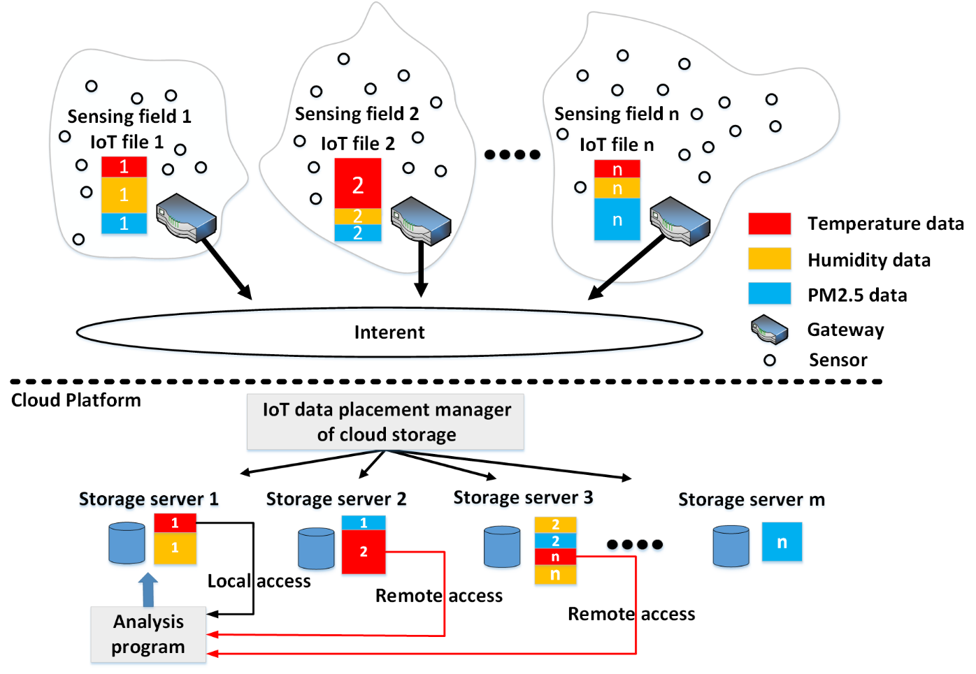
IoT Cloud Application Case
Smart city data analysis
Deploying a number of sensors in each city sensing field.
The sensors in a sensing field send the interested data to the corresponding gateway.
The gateway forwards the collected sensed data to the cloud platform via Internet.
Performing data analysis.
If we directly store the IoT files in the allocated storage blocks of cloud storage in sequence, an IoT sensing event will have many data segments in cloud storage.
The sensing event temperature has three data segments in the cloud storage servers 1, 2, and 3. While analyzing the temperature event, even if the analytical program runs in one of the three cloud storage servers, the program still needs to retrieve two remote temperature data segments.

Slide 6
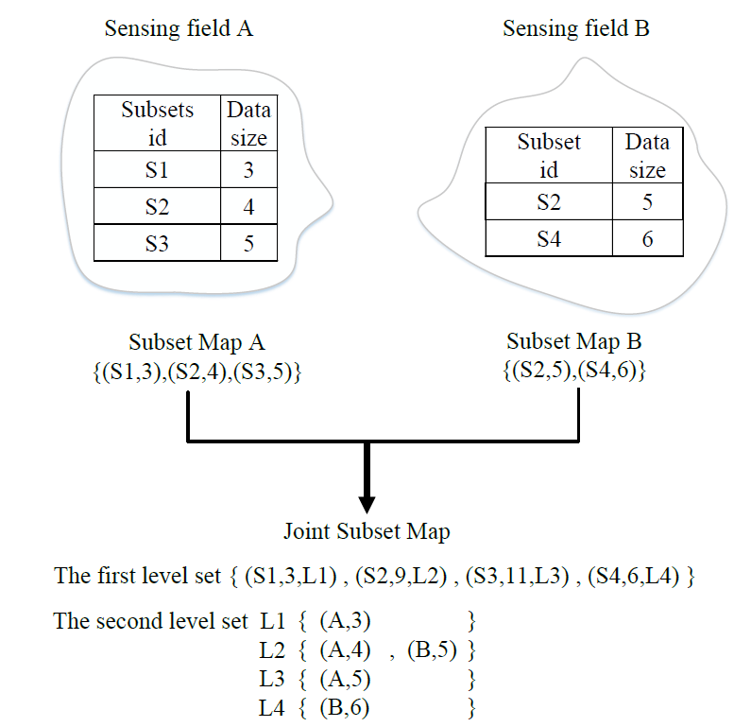
IoT Cloud Application Case
Data structure to represent IoT subset distribution
The first level set has the following element format:
(subset id, total subset data size, and link).
For the second level set, the data structure is :
(sensing field id, and the subset data size)

Slide 7
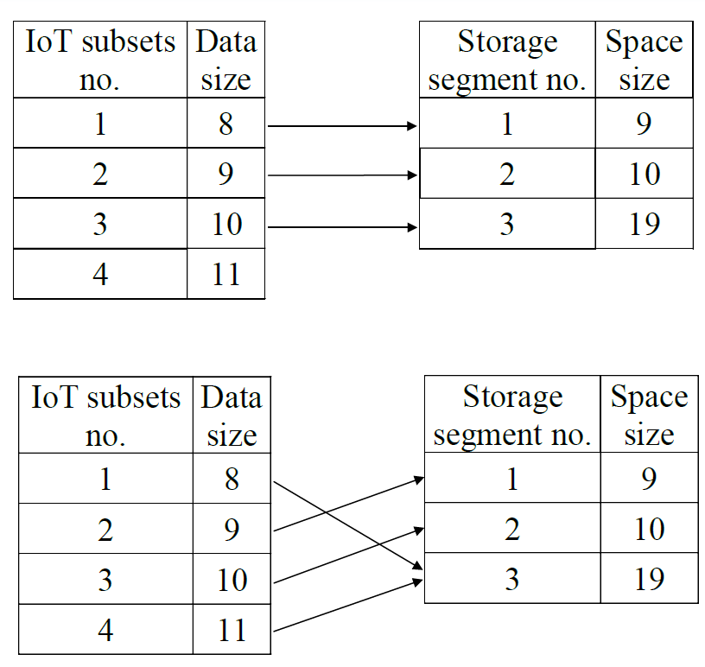
IoT Cloud Application Case
Placement combination problem
The IoT subsets themselves have different data sizes. To place an IoT subset in a proper storage segment, we need to consider both size mapping and priority problems.
If we place four IoT subsets in a sequence, only the IoT subsets 1, 2, and 3 can be placed successfully. The highest-priority IoT subset 4 cannot be fully placed in a storage segment.
If we place the IoT subsets 1 and 4 in the storage segment 3, all four IoT subsets can be placed successfully

Slide 8
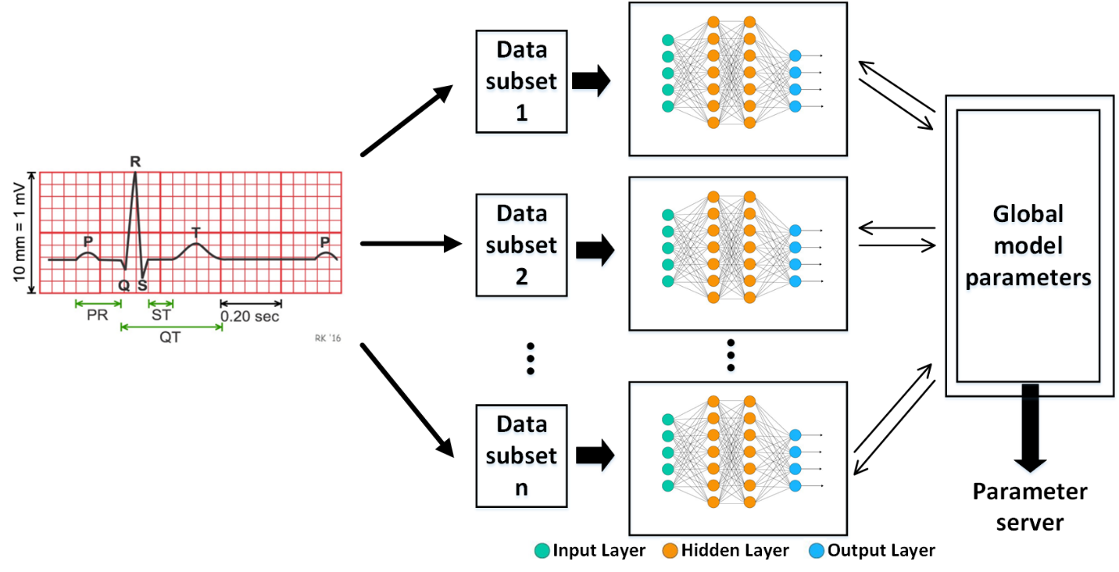
IoT Cloud Application Case
ECG medical care
ECG data is collected from a large amount of patients.
Heart diagnosis model is trained based on a distributed deep learning model.
The trained model is fed into the personal medical device or the edge server close to people.
Heart warning messages is detected and it is sent to hospitals, clinics, or emergency units.

Slide 9
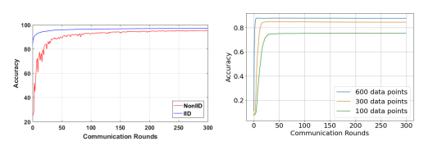
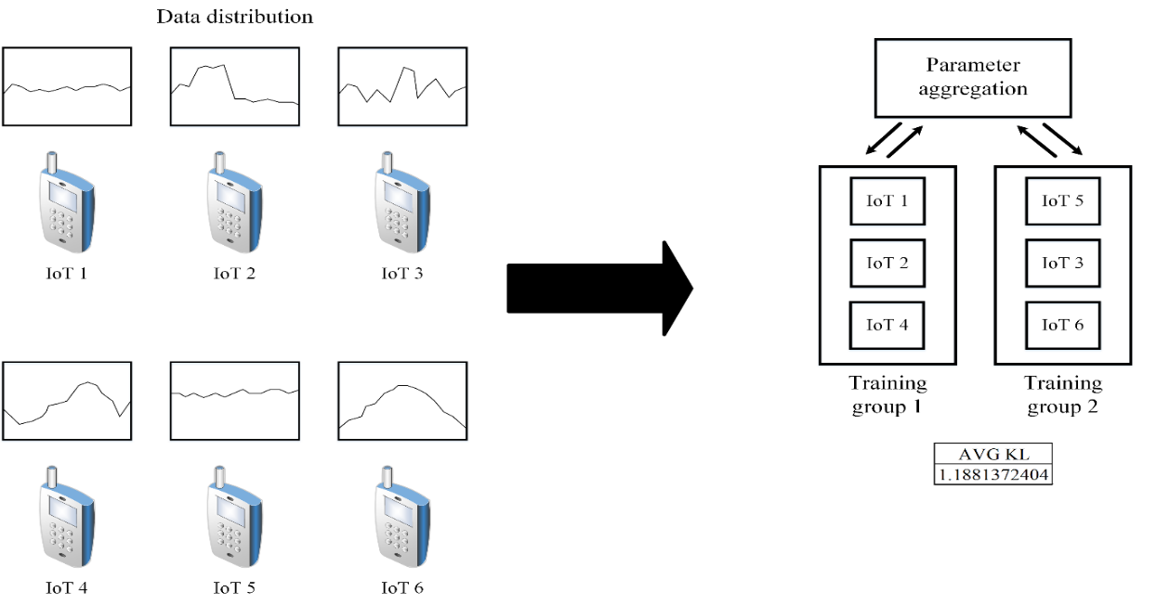
IoT Cloud Application Case
Data distribution and amount of data v.s. accuracy
IID better than NonIID based on uniform distribution
More data better than less data
MNIST dataset
Handwritten digit dataset
Labels {0, 1, 2, 3, …9}
Uniform distribution {1/10, 1/10, …1/10}
Data combination to enhance accuracy
Transformation from NonIID distribution to IID-like distribution
A way of comparing two probability distributions called Kullback-Leibler Divergence (KLD) based on uniform distribution
Smaller KLD value close to the uniform distribution
KLD=2.43378 v.s. KLD=1.18813

Slide 10
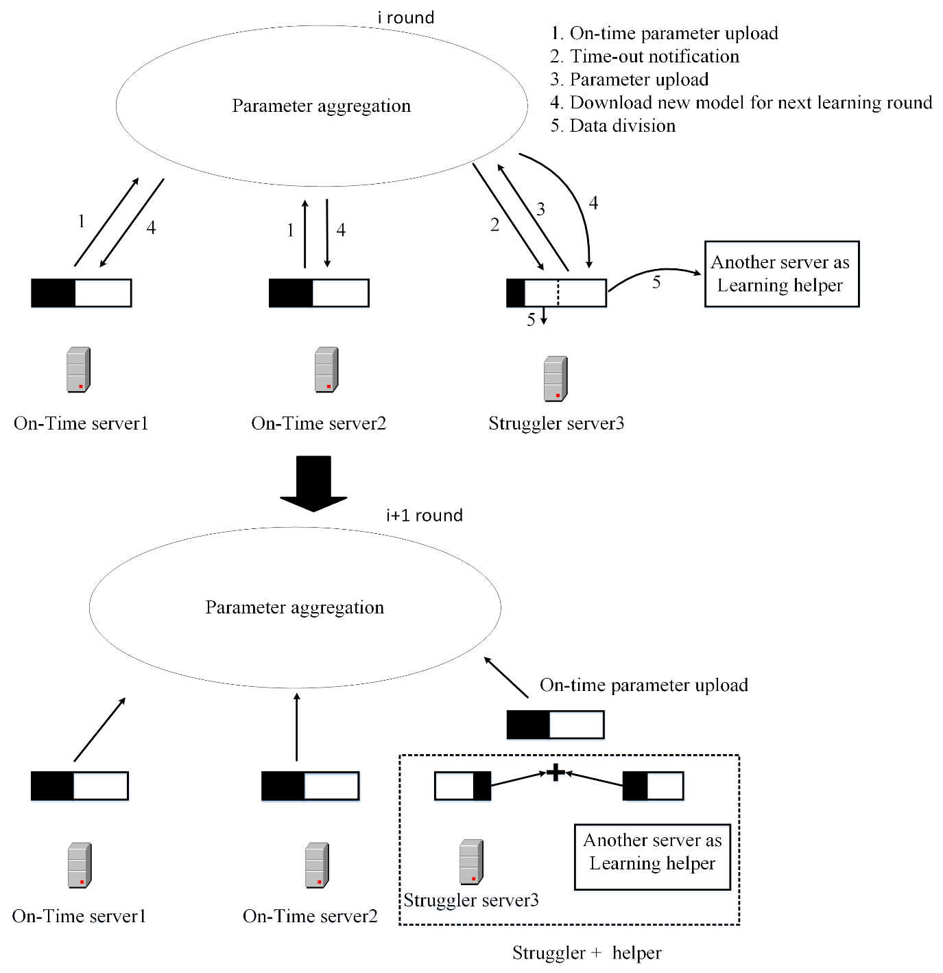
IoT Cloud Application Case
Device heterogeneity in distributed deep learning
Waiting-time bound for learning straggler
Finding learning helper
Estimating the amount of assistant-learning data

