Slide 1
Lecture 4a
Mobile IP
1

Slide 2
Outline
How to support Internet mobility?
– by Mobile IP.
Our discussion will be based on IPv4 (the current version).
2

Slide 3
IP Address
IP address is a 32-bit number assigned to each network interface of a node.
Nodes (such as routers) with multiple network interfaces have multiple IP addresses.
IP Address in Dotted-Decimal Notation
3

Slide 4
Network Prefix; Host Portion
An IP address has two components
Network prefix
Identifying a link
Identical for all nodes attached to the same link
Host portion
Identifying a specific host or router connected to that link
Example: 129.61.18.26, prefix length = 24
Network prefix = 129.61.18
Host portion = 26
4

Slide 5
Routing Table
Host 1
Router A Router B
Router C
a
Host 1 wants to forward a packet to 7.7.7.1
Rules for Routing:
Compare the left-most Prefix-Length bits of each Target with the IP destination address.
Choose the matching route with the largest Prefix-Length.
Host 1’s routing table
Target / Prefix- Length | Next Hop | Interface
7.7.7.99 / 32 | router 1 | a
7.7.7.0 / 24 | router 2 | a
0.0.0.0 / 0 | router 3 | a
Default route
5

Slide 6
A Routing Example: 1.0.0.1 → 2.0.0.4
Ethernet B Network Prefix = 2.0.0
Host 3 Host 4
Ethernet A Network Prefix = 1.0.0
High-Speed Fiber Backbone Network Prefix = 3.0.0
Router B
b
b
Host 1
Host 2
b
3.0.0.253 _{c}
2.0.0.3 2.0.0.4
2.0.0.253
Router A
a
a
a
c
Host 5
1.0.0.1
1.0.0.2
1.0.0.254
3.0.0.254
c
b b
3.0.0.252
Router C
4.0.0.5
4.0.0.252
Ethernet C Network Prefix = 4.0.0
6
Host 1’s routing table
Target/Prefix-Length | Next Hop | Interface
1.0.0.0 / 24 | “direct” | a
0.0.0.0 / 0 | 1.0.0.254 | a

Slide 7
A Routing Example: 1.0.0.1 → 2.0.0.4
Ethernet B Network Prefix = 2.0.0
Host 3 Host 4
Ethernet A Network Prefix = 1.0.0
High-Speed Fiber Backbone Network Prefix = 3.0.0
Router B
b
b
Host 1
Host 2
b
3.0.0.253 _{c}
2.0.0.3 2.0.0.4
2.0.0.253
Router A
a
a
a
c
Host 5
1.0.0.1
1.0.0.2
1.0.0.254
Router A’s routing table
3.0.0.254
c
b
3.0.0.252
b
Target/Prefix-Length | Next Hop | Interface
1.0.0.0 / 24 | “direct” | a
3.0.0.0 / 24 | “direct” | c
2.0.0.0 / 24 | 3.0.0.253 | c
4.0.0.0 / 24 | 3.0.0.252 | c
Router C
4.0.0.5
4.0.0.252
Ethernet C Network Prefix = 4.0.0
7

Slide 8
A Routing Example: 1.0.0.1 → 2.0.0.4
Ethernet B Network Prefix = 2.0.0
Host 3 Host 4
Ethernet A Network Prefix = 1.0.0
High-Speed Fiber Backbone Network Prefix = 3.0.0
Router B
b
b
Host 1
Host 2
b
3.0.0.253 _{c}
2.0.0.3 2.0.0.4
2.0.0.253
Router A
a
a
a
c
Host 5
1.0.0.1
1.0.0.2
1.0.0.254
Router B’s routing table
3.0.0.254
c
b
3.0.0.252
b
Router C
4.0.0.5
Target/Prefix-Length | Next Hop | Interface
1.0.0.0 / 24 | 3.0.0.254 | c
2.0.0.0 / 24 | “direct” | b
3.0.0.0 / 24 | “direct” | c
4.0.0.252
Ethernet C Network Prefix = 4.0.0
8

Slide 9
A Routing Example: 1.0.0.1 → 2.0.0.4
Ethernet B Network Prefix = 2.0.0
Host 3
Ethernet A Network Prefix = 1.0.0
High-Speed Fiber Backbone Network Prefix = 3.0.0
Router B
?
b
Host 1
Host 2
b
3.0.0.253 _{c}
2.0.0.3
2.0.0.253
Router A
a
a
a
c
Host 5
Host 4
1.0.0.1
1.0.0.2
1.0.0.254
Router B’s routing table
3.0.0.254
c
b b
b
3.0.0.252
Router C
4.0.0.5
4.0.0.252
2.0.0.4
Target/Prefix-Length | Next Hop | Interface
1.0.0.0 / 24 | 3.0.0.254 | c
2.0.0.0 / 24 | “direct” | b
3.0.0.0 / 24 | “direct” | c
Ethernet C Network Prefix = 4.0.0

Slide 10
Problem
The packet is undeliverable
– Host 4 is not connected to Ethernet B.
Router B will then send a Host Unreachable
error message back to Host 1.
Q: How to solve it?

Slide 11
Solution 1: Host-Specific Route
Place host-specific routes in the routing tables of Router A, B, and C as follows:
Target/Prefix-Length | Next Hop | Interface
2.0.0.4 / 32 | 3.0.0.252 | c
Is this a good solution?
Router A
Target/Prefix-Length | Next Hop | Interface
2.0.0.4 / 32 | 3.0.0.252 | c
Router B
Router C
Target/Prefix-Length | Next Hop | Interface
2.0.0.4 / 32 | “direct” | b

Slide 12
Solution 2: Change IP Address
Simply change the IP address of host 4, as it moves from Ethernet B to Ethernet C.
For example, Dynamic Host Configuration Protocol (DHCP) can be used to acquire a new IP address.
Q: Is this a good solution?

Slide 13
Solution 3: Mobile IP
A standard proposed to solve the problem of Internet mobility.
It allows the mobile node to use two IP addresses:
a fixed home address
a care-of address that changes at each new point of attachment

Slide 14
Entities and Relationships
Mobile Node
“visiting” a foreign link
Mobile Node “at home”
Foreign Agent
Foreign Link
Home Link – the link having the same network prefix as the node’s IP address
Home Agent – a router on the mobile node’s home link.
Foreign Agent
Foreign Link

Slide 15
Care-of Address
Two conceptual types of care-of addresses
Foreign agent care-of address
Collocated care-of address

Slide 16
Foreign Agent Care-of Address
IP address of a foreign agent which has an interface on the foreign link.
– The foreign agent may have more than one IP address; hence, the network-prefix need not equal the network prefix of the foreign link
The same address can be shared by many mobile nodes simultaneously.

Slide 17
Collocated Care-of Address
An IP address temporarily assigned to a mobile node.
– It can be used by only one mobile node at a time.
The network prefix must equal the network prefix of the foreign link.
It might be used by a mobile node in situations where no foreign agents are available.

Slide 18
Three Mechanisms
Agent Discovery
Registration
Routing

Slide 19
1. Agent Discovery
Home Agents and Foreign Agents periodically broadcasts Agent Advertisements.
e.g. once every few seconds
If the mobile node does not want to wait for the periodic advertisement, it can broadcast Agent Solicitations that will be answered by any foreign agent that receives it.
Mobile nodes determine whether they have moved from one link to another. (How?)

Slide 20
Move Detection
Agent Advertisement has a Lifetime field.
– specify how soon a mobile node should expect to hear another advertisement from that same agent.
If the mobile node fails to hear an advertisement from that agent within the specified Lifetime, then it assumes that it has moved to a different link.

Slide 21
Care-of Address
A mobile node connected to a foreign link acquire a foreign agent care-of-address from the Agent Advertisements.
– If multiple care-of-addresses are listed, any one of them can be used.
If a foreign agent is unavailable, the mobile node obtain a collocated care-of address by Dynamic Host Configuration Protocol (DHCP).

Slide 22
DHCP
Goal
– allow host to dynamically obtain its IP address from network server when it joins a network
A client-server protocol
Four-way handshake

Slide 23
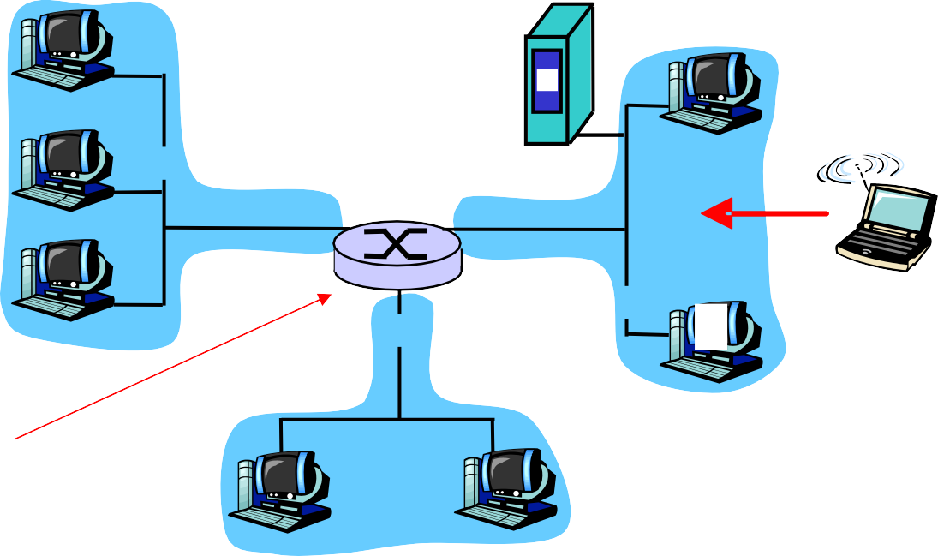
DHCP Client-Server Scenario
223.1.1.1
DHCP
server
223.1.2.1
223.1.1.2
223.1.1.4 223.1.2.9
223.1.2.2 _{E}
223.1.3.2
arriving DHCP client needs address in this network
223.1.1.3
223.1.3.27
223.1.3.1
DHCP relay agent (typically a router) for
223.1.1 and 223.1.3.
It knows the address of a DHCP server for these networks.

Slide 24
Broadcast
arriving Address:
DHCP server: 223.1.2.5
DHCP discover
client 255.255.255.255
UDP port 67
src : 0.0.0.0, 68
dest.: 255.255.255.255,67
yiaddr: 0.0.0.0
transaction ID: 654
Allocates an IP address and set the time for which the address will be valid.
What is source address?
DHCP offer
src: 223.1.2.5, 67
dest: 255.255.255.255, 68
yiaddrr: 223.1.2.4
transaction ID: 654
Lifetime: 3600 secs
Choose an offer if more than one server replies.
DHCP request
src: 0.0.0.0, 68
dest:: 255.255.255.255, 67
yiaddrr: 223.1.2.4
transaction ID: 655
Lifetime: 3600 secs
time
DHCP ACK
src: 223.1.2.5, 67
dest: 255.255.255.255, 68
yiaddrr: 223.1.2.4
transaction ID: 655
Lifetime: 3600 secs

Slide 25
2. Registration
Registration is the process by which a mobile node
requests routing services from a foreign agent;
informs its home agent of its current care-of address;
renews a registration which is due to expire;
deregisters when it returns to its home link.

Slide 26
Scenario 1: Registering Foreign Agent Care-of Address
The mobile node, with the assistance of a foreign agent, sends a Registration Request with the care-of address information.
1
2
Mobile Node “visiting” a foreign link
Home Agent
Foreign Agent
4
3
When the home agent receives this request, it adds the necessary information to its routing table, and sends a Registration Reply back to the mobile node.

Slide 27
Scenario 2: Registering Collocated Care-of Address
Registration Request
Mobile Node “visiting” a foreign link
Home Agent
Registration Reply

Slide 28
Scenario 3: Deregistration
Mobile Node returns to its home link
1. (de-)Registration Request
Home Agent
2. (de-)Registration Reply

Slide 29
Authentication
The home agent must be certain that registration was originated by the mobile node and not by some other malicious node.
Registration of the care-of address requires authentication.
The mobile node needs to prove its identity to its home agent.
It is done by making use of a secret key known only to the mobile node and its home agent.

Slide 30
3. Routing
Different Scenarios:
Mobile Node → Correspondent Node
Correspondent Node → Mobile Node
With a foreign agent
Without a foreign agent

Slide 31
How to Send Packets to a Correspondent Node?
Mobile Node
Foreign Agent
Home Agent
Simply use the Correspondent’s IP address as the destination address.
Correspondent
How about the source address? Original IP address? Care-of Address?

Slide 32
How to Send Packets to a Mobile Node?
Mobile Node
Foreign Agent
Home Agent
Source address | Correspondent’s IP address
Destination address | Mobile’s IP address
Correspondent

Slide 33
Tunneling to the Care-of Address
Home Agent intercepts packets destined to the mobile node’s home address and tunnels them to the mobile node’s care-of address.
Mobile Node “visiting” a foreign link
Foreign Agent
Tunnel
Home Agent
Foreign Agent removes original packet from the tunnel and delivers the original packet to the mobile node over the foreign link.

Slide 34
IP in IP Encapsulation
Ipsrc = Original Sender
Ipdes = Destination’s Home Address
Original IP packet
Header
Payload
The home agent inserts a new IP header, or tunnel header, in front of the IP header of any datagram addressed to the mobile node’s home address.
Ipsrc = Home Agent
Ipdes = Mobile node’s Care-of Address
Outer Header
Header
Payload
Encapsulating IP packet
Outer Payload

Slide 35
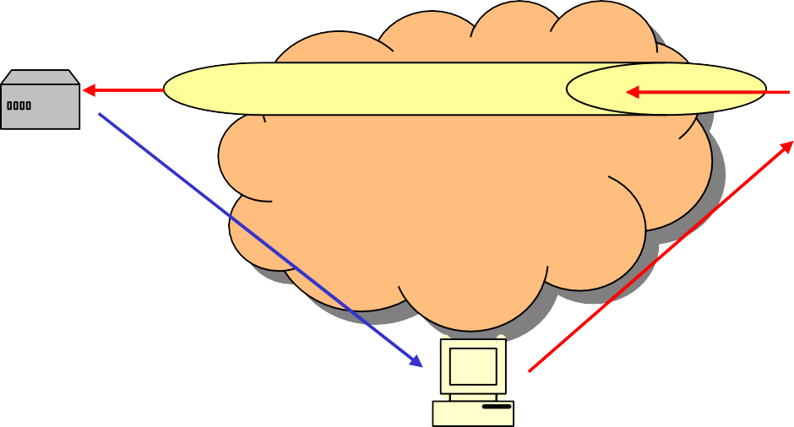
Triangle Routing
Mobile Node “visiting” a foreign link
Foreign Agent
Home Agent
Why doesn’t the mobile node inform the correspondent of its care-of address and have it tunnel directly to the mobile node?
Correspondent

Slide 36
Optimized Routing
Mobile Node “visiting” a foreign link
Foreign Agent
Home Agent
This is potentially more efficient in terms of delay and resource consumption.
Why is it not used?
Correspondent

Slide 37
Main Obstacle: Security
A bad guy sends a fake registration to the correspondent
Mobile Node “visiting” a foreign link
Foreign Agent
Home Agent
Correspondent
It is impractical to distribute keys between a mobile node and every other node with which it might correspond.

Slide 38
References
J. D. Solomon, Mobile IP: the Internet unplugged, Prentice Hall, 1998.
C. E. Perkins, “Mobile networking through mobile IP,”
IEEE Internet Computing, pp. 58-69, Jan/Feb, 1998.

