Slide 1
Interference-Aware Virtual Machine Placement in Cloud Computing Systems
Jenn-Wei Lin and Chien-Hung Chen
Department of Computer Science and Information Engineering
Fu Jen Catholic University, Taiwan, R.O.C.
ICCIS2012, Kuala Lumpur, Malaysia.
June 12-14, 2012.

Slide 2
Outline
Introduction
Background
Proposed Algorithm
Simulation Experiments
Conclusions

Slide 3
Introduction
Scalable computing and storage resources in cloud computing systems
Infrastructure as a service (IaaS) delivery model
Provisioning a large number of virtual machines (VMs) to run applications
Virtualizing the computing and storage resources of all physical machines (PMs)
Interference among VMs (VM interference) in the same PM
Non-sliceable resources (e.g. disk I/O, network I/O, etc) in the PM be commonly used by VMs
Investigating the Interference-Aware Virtual Machine Placement (IAVMP) problem in cloud computing systems

Slide 4
Introduction
Three factors to be considered in the IAVMP problem
Resource utilization of PMs
VM interference
QoS requirements of cloud applications
The IAVMP problem is an NP-hard problem
The well-known multiple knapsack problem can be reduced to the IAVMP problem
Proposing a heuristic algorithm to efficiently solve the IAVMP problem

Slide 5
Background
Controller node
System model
Two-level cloud system architecture
Managing resources of PMs VM placement
Hosting VMs in their available resources
Controller node
Physical machine node

Slide 6
Background
Related work
S. Chaisiri, B.-S. Lee, and D. Niyato, “Optimization of Resource Provisioning Cost in Cloud Computing,” IEEE Trans. Services Comput., vol. 99, 2011.
Authors proposed an optimal cloud resource provisioning algorithm to provision resources for VMs.
Benders decomposition and sample-average approximation are applied in the algorithm
QoS requirements of applications and VM interference are not taken into account in the proposed algorithm.

Slide 7
Background
Related work
X. Pu, L. Liu, Y. Mei, S. Sivathanu, Y. Koh, C. Pu, and Y. Cao, “Who is Your Neighbor: Net I/O Performance Interference in Virtualized Clouds,” IEEE Trans. Services Comput., vol. 99, 2012.
Authors studied the VM interference caused by different I/O workloads of applications.
The work of analyzing VM interference is based on the monetary cost.
This work did not discuss how to take VM interference into the design of the VM placement algorithm.

Slide 8
Proposed Algorithm
IAVMP problem is NP-hard
Reducing the well-known NP-hard problem to the IAVMP problem
Multiple knapsack (MK) problem
Proof
MK problem | IAVMP problem
Items | VMs
Knapsacks | PMs
Profit and weight of an item | Rental price and resource demand of a VM
Capacity of a knapsack | Amount of resources in a PM

Slide 9
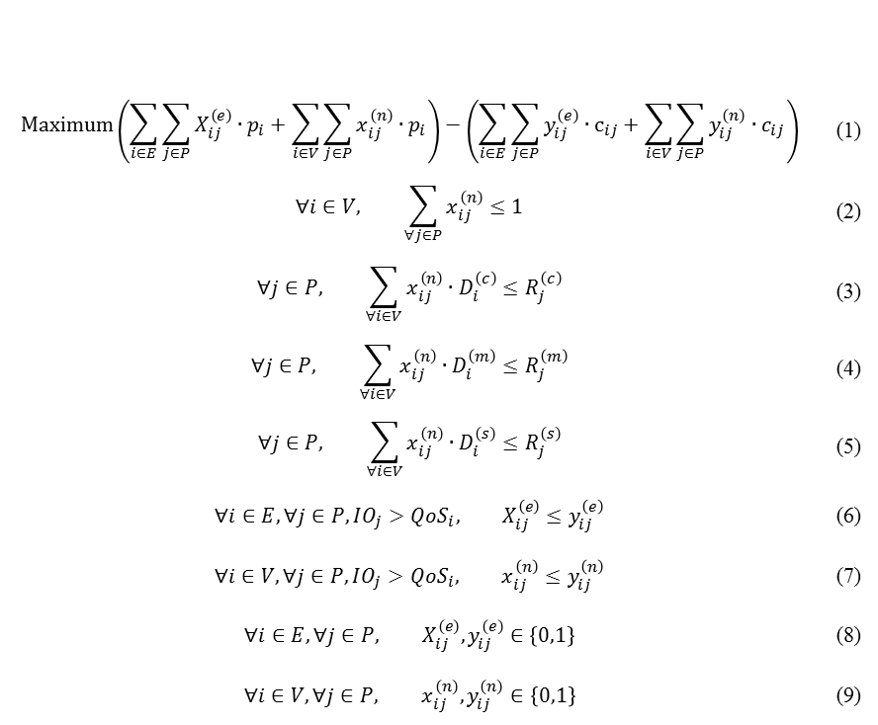
Proposed Algorithm
Linear programming model for IAVMP
=
－
$$Profit Price Penalty$$
$$\text{M}\text{axi}\text{m}\text{um}\left(\sum_{i∈E}{\sum_{j∈P}{X_{ij}^{\left(e\right)}∙p_{i}}}+\sum_{i∈V}{\sum_{j∈P}{x_{ij}^{\left(n\right)}∙p_{i}}}\right)−\left(\sum_{i∈E}{\sum_{j∈P}{y_{ij}^{\left(e\right)}∙c_{ij}}}+\sum_{i∈V}{\sum_{j∈P}{y_{ij}^{\left(n\right)}∙c_{ij}}}\right)$$ | (1)
$$∀i∈V, \sum_{∀j∈P}{x_{ij}^{\left(n\right)}}≤1$$ | (2)
$$∀j∈P, \sum_{∀i∈V}{x_{ij}^{\left(n\right)}∙D_{i}^{\left(c\right)}}≤R_{j}^{\left(c\right)}$$ | (3)
$$∀j∈P, \sum_{∀i∈V}{x_{ij}^{\left(n\right)}∙D_{i}^{\left(m\right)}}≤R_{j}^{\left(m\right)}$$ | (4)
$$∀j∈P, \sum_{∀i∈V}{x_{ij}^{\left(n\right)}∙D_{i}^{\left(s\right)}}≤R_{j}^{\left(s\right)}$$ | (5)
$$∀i∈E,∀j∈P,IO_{j}>QoS_{i}, X_{ij}^{\left(e\right)}≤y_{ij}^{\left(e\right)}$$ | (6)
$$∀i∈V,∀j∈P,IO_{j}>QoS_{i}, x_{ij}^{\left(n\right)}≤y_{ij}^{\left(n\right)}$$ | (7)
$$∀i∈E,∀j∈P, X_{ij}^{\left(e\right)},y_{ij}^{\left(e\right)}∈\left\{0,1\right\}$$ | (8)
$$∀i∈V,∀j∈P, x_{ij}^{\left(n\right)},y_{ij}^{\left(n\right)}∈\left\{0,1\right\}$$ | (9)
Objective Function
One VM in one PM
Resource constraints
QoS violation verification
The variables X and Y are to keep track the VM placement and the QoS violation event

Slide 10
Proposed Algorithm
Heuristic algorithm
Flowchart

Slide 11
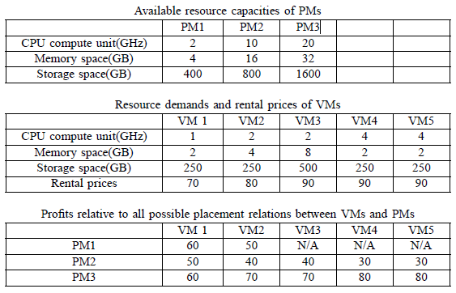
Proposed Algorithm
Heuristic algorithm (Cont.)
Bipartite graph establishment
Modeling all the placement relationships between VMs and PMs
Available resource capacity of PMs
Resource demands and rental prices of VMs
Bipartite graph
An example of the IAVMP problem
Profits relative to all possible placement relations between VMs and PMs

Slide 12
Proposed Algorithm
Heuristic algorithm (Cont.)
Contention phase
Resolving the VM placement conflict by the profit comparison
Placement phase
Placing the selected VMs to the PMs
Updating the available resources of PMs
Reformation phase
Reconstructing the bipartite graph

Slide 13
Simulation Experiments
Simulation Environment
MATLAB
Our heuristic IAVMP algorithms and three intuitive VM algorithms: random-fit, first-fit, and least-fit
250 PMs
100 to 500 VMs
Referring to Amazon EC2 to set the price of a VM and the QoS requirement of an application in a VM
Simulation metrics
Profit
Number of QoS-violated VMs
Penalty payment due to QoS violation
Number of placed VMs

Slide 14
Simulation Results
Profit
The heuristic algorithm enhances the profits by about 45% .
Number of QoS-Violated VMs
The heuristic algorithm has a smooth increase in the number of QoS-violated VMs.
Penalty Payment
The penalty payment in the heuristic algorithm is about one-fifth of the other algorithms.
Number of placed VMs
The proposed heuristic algorithm is close to the other algorithms in the number of placed VMs

Slide 15
Conclusions
Our studied IAVMP problem takes the QoS requirements of applications and VM interference into the VM placement.
We formulate the IAVMP problem as an ILP model to obtain the optimal solution.
We further propose a polynomial-time heuristic placement algorithm.
It is also suitable to solve the IAVMP problem in a large-scale cloud computing system.
From the simulation results, the proposed algorithm can offer better performance than existing algorithms.

