Slide 1
Key Technologies in Cloud Computing and Its Applications
Prof. Jenn-Wei Lin
Department of Computer Science and Information Engineering
Fu Jen Catholic University, Taiwan (R.O.C.)

Slide 2
Outline
Introduction to Cloud Computing
Hadoop Data File System (HDFS)
Hadoop MapReduce Framework
Cloud Research Issues
NSC Joint Cloud Project
Conclusions

Slide 3
What is Cloud Computing?
Cloud Computing is a general term used to describe a new class of network based computing
Using the network to provide hardware and software services to users.
Hiding the complexity and details of the underlying infrastructure from users and applications
Very simple graphical interface, API (Applications Programming Interface), Web-based Applications.

Slide 4
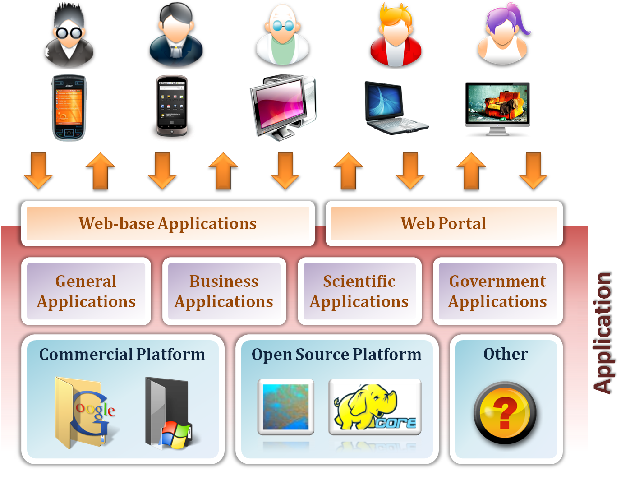
Cloud Computing Services from Users
The applications are accessible from various thin client devices.

Slide 5





Delivery Models
SaaS
Software as a Service
PaaS
Platform as a Service
IaaS
Infrastructure as a Service

Slide 6
Dropbox
2GB 的免費線上儲存空間，最大可付費加大到 100GB 。
同步 Windows, Mac, Linux 電腦及 iPhone, iPad, Andriod 手機，同步 只會傳送檔案變動的部份而不是整個檔案。
離線你還是可以使用本機 Dropbox 資料夾的檔案，一旦網路恢復連線檔案就會自動同步。
Dropbox 檔案有續傳 的功能，會從傳輸中斷的地方繼續而不會重頭再來。
可以設定上傳/下載頻寬，不會佔滿你的網路頻寬。
https://www.dropbox.com/features

Slide 7
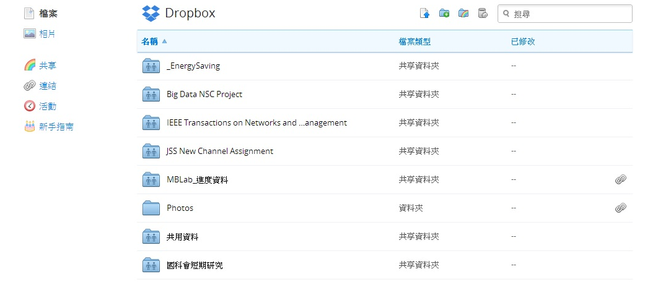
Dropbox

Slide 8
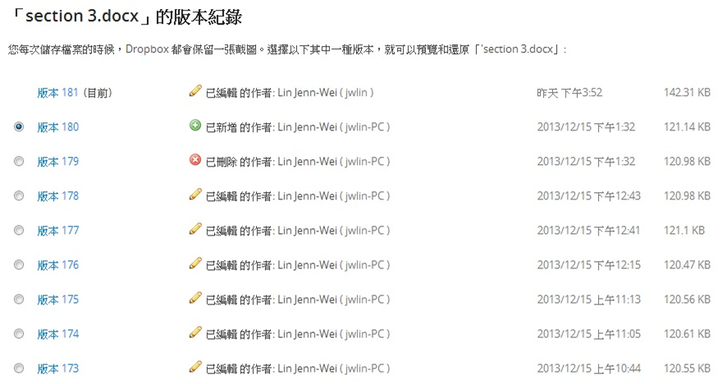
Dropbox

Slide 9
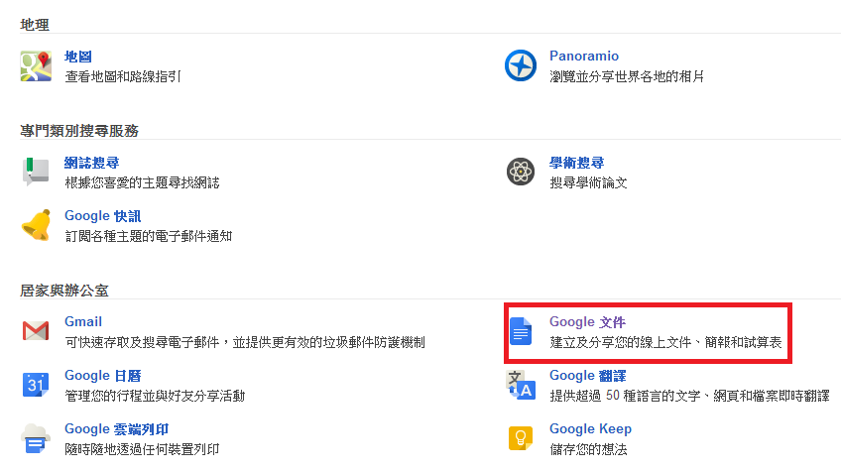
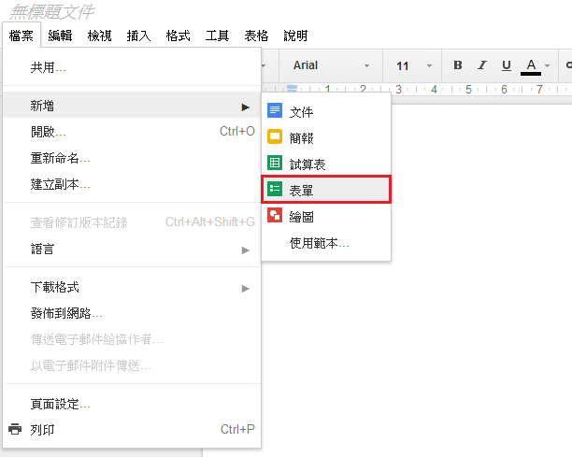
Google Docs表單

Slide 10
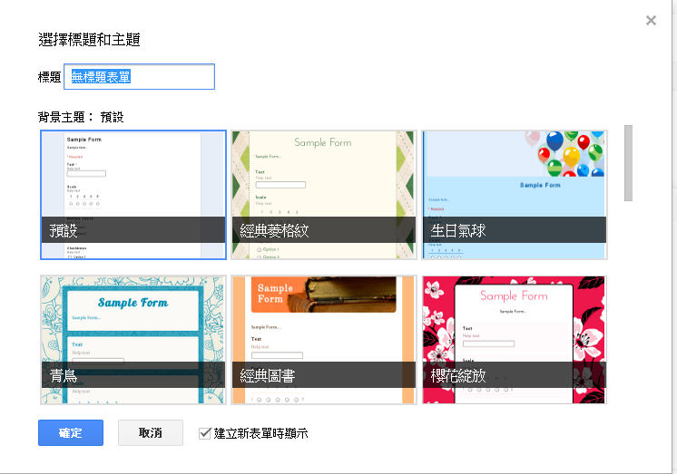
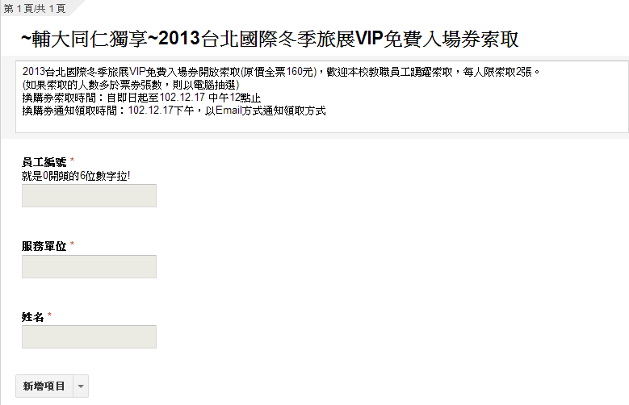
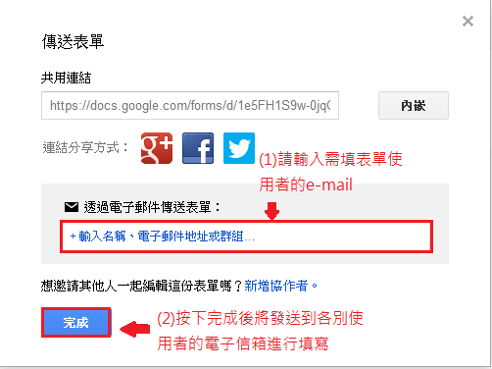
Google Docs表單

Slide 11

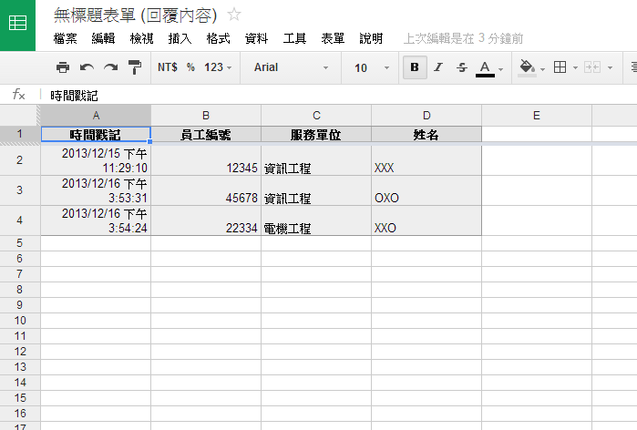
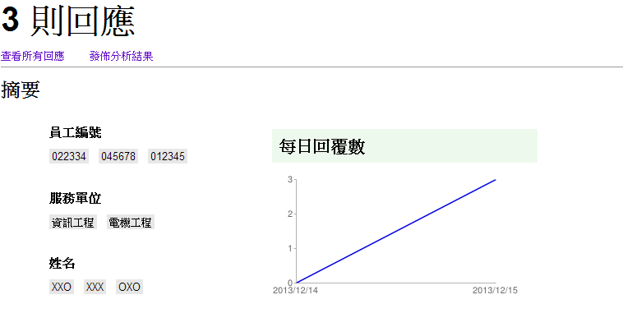
Google Docs表單

Slide 12
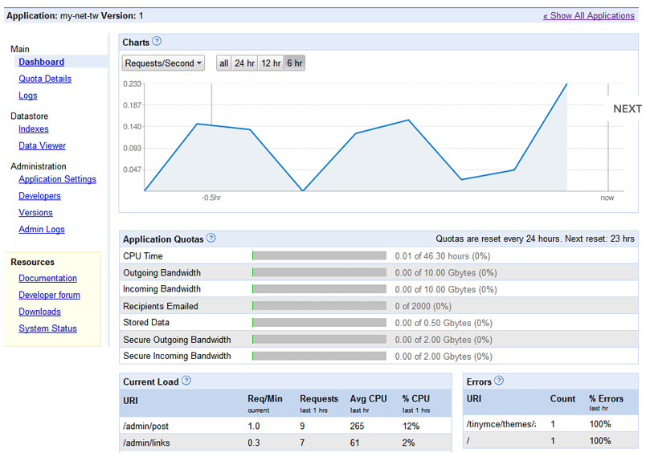
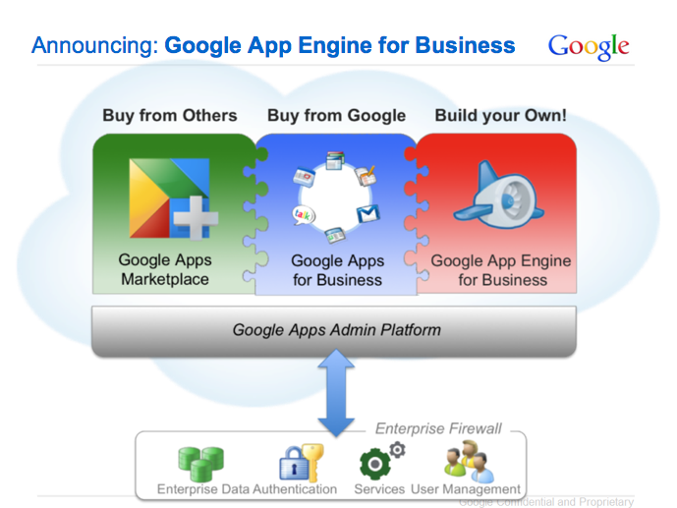
Google App Engine (GAE)
GAE讓程式開發者可以在 Google 的基礎架構上執行網路應用程式
開發者不需要維護伺服器，只要上傳網路應用程式
GAE提供動態網頁服務，完全支援常見的網頁技術
GAE提供自動擴充和負載平衡
GAE具備Administration Console
協同開發
error logs、analyze traffic
Google App Engine Administration Console
Notes:
另外一項軟體即服務Google Documents.
只要連上網頁就能檢視, 編輯文件, 不需額外安裝Microsoft Office或Open Office

Slide 13
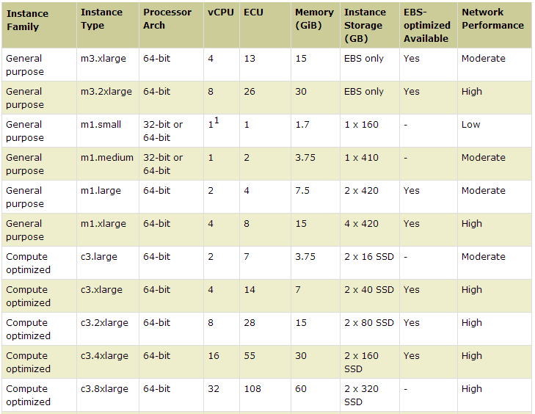

Amazon Elastic Compute Cloud (EC2)
ECU: 1.2 GHz 2007 Xeon processor
File Format Transformation using VMs

Slide 14
Virtualization
Multiple virtual machines to run on a single physical machine
App
App
App
App
App
Xen
Guest OS
(Linux)
Guest OS
(NetBSD)
Guest OS
(Windows)
VMWare
VM
VM
VM
UML
Virtual Machine Monitor (VMM) / Hypervisor
Denali
Hardware
etc.

Slide 15
Google in Cloud Computing
可靠資料儲存資料
Google File System (GFS) (2003): distributed storage
多台機器上執行工作
MapReduce (2004): simplified large-scale data processing
處理大量的具結構化資料
BigTable (2006): database (storage of structured data) beyond the scale of single machine

Slide 16
Hadoop
Google發表論文GFS , MapReduce , BigTable‏
Hadoop計畫實做
Hadoop Project
Apache Software Foundation
Open Source
利用Java實作Google的3項軟體技術
HDFS (Hadoop Distributed File System) Hadoop MapReduce, and Hbase

Slide 17
Hadoop
DataBase
Parallel Processing
File System
The other components of Hadoop
Pig | Dataflow language and parallel execution Framework
Hive | Data warehouse infrastructure
ZooKeeper | Distributed coordination service
Chukwa | System for collecting management data
Avro | Data serialization system
Notes:
接下來將介紹我們所使用的Hadoop雲端平台裡裡面幾個主要核心的元件
裡面包含 (HDFS全名) HDFS
它為Hadoop裡的分散式檔案系統，用於儲存檔案
在來是Hbase ，它為Hadoop的資料庫系統，
而它所儲存的資料皆會透過HDFS來進行儲存
再來是mapreduce 它為Hadoop的平行運算元件
它可將處理過後的資料儲存至Hbase
再來就是雲端應用程式
它可提供開發者將設計好的軟體放置Hadoop上做執行

Slide 18
Outline
Introduction to Cloud Computing
Hadoop Data File System (HDFS)
Hadoop MapReduce Framework
Cloud Research Issues
NSC Joint Cloud Project
Conclusions

Slide 19

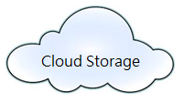
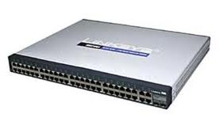

HDFS Network Topology
Rack0
Rack1
Rack2
Notes:
網路的拓樸結構

Slide 20

File in HDFS
App
File
(100MB)
Temp
Block
64MB
Temp
Block
36MB
Block
64MB
Block
64MB
Block
64MB
Block
36MB
Block
36MB
Block
36MB
DN
DN
DN
DN
DN
DN: DataNode

Slide 21

Block Write in HDFS
NameNode
Write Request
DataNode List
Block Data
DataNodes
Notes:
Hadoop Distributed File System of PDF page2

Slide 22
Block Read in HDFS
NameNode
Read Request
DataNode List
Block Data
DataNodes
Notes:
Hadoop Distributed File System of PDF page2

Slide 23
Outline
Introduction to Cloud Computing
Hadoop Data File System (HDFS)
Hadoop MapReduce Framework
Cloud Research Issues
NSC Joint Cloud Project
Conclusions

Slide 24
Hadoop MapReduce
Hadoop MapReduce is a software framework for easily writing applications to process vast amounts of data in HDFS.
應用層面
大量數據資料的分析統計
大量資料的排序彙整
網頁存取紀錄的分析
Notes:
Hadoop MapReduce is a software framework for easily writing applications which process vast amounts of data (multi-terabyte data-sets) in-parallel on large clusters (thousands of nodes) of commodity hardware in a reliable, fault-tolerant manner.

Slide 25
MapReduce Framwork
Master node
Jobtracker
Job Submission
⁞
Job 3
Job 2
Job 1
FIFO Queue
Map 1
Map 2
…
Map m
Reduce 1
Reduce 1
…
Reduce n
Map task
Map task
……
Reduce task
Reduce task
Work node 1
(Tasktracker)
Work node 2 (Tasktracker)
Work node K-1 (Tasktracker)
Work node K (Tasktracker)
Hadoop runs a MapReduce.

Slide 26
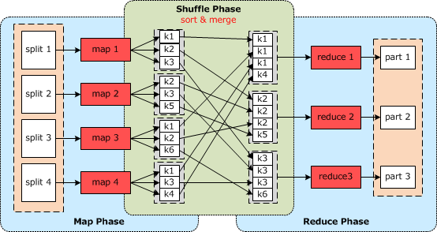
MapReduce Framwork
Input Data

Slide 27
MapReduce Computing Example
WordCount
Map Function
public static class Map extends MapReduceBase implements Mapper<LongWritable, Text, Text, IntWritable> {
private final static IntWritable one = new IntWritable(1);
private Text word = new Text();
public void map(LongWritable key, Text value, OutputCollector<Text, IntWritable> output, Reporter reporter) throws IOException {
String line = value.toString();
StringTokenizer tokenizer = new StringTokenizer(line);
while (tokenizer.hasMoreTokens()) {
word.set(tokenizer.nextToken());
output.collect(word, one);
}
}
}
Reduce Function
public static class Reduce extends MapReduceBase implements Reducer<Text, IntWritable, Text, IntWritable> {
public void reduce(Text key, Iterator<IntWritable> values, OutputCollector<Text, IntWritable> output, Reporter reporter) throws IOException {
int sum = 0;
while (values.hasNext()) {
sum += values.next().get();
}
output.collect(key, new IntWritable(sum));
}
}

Slide 28
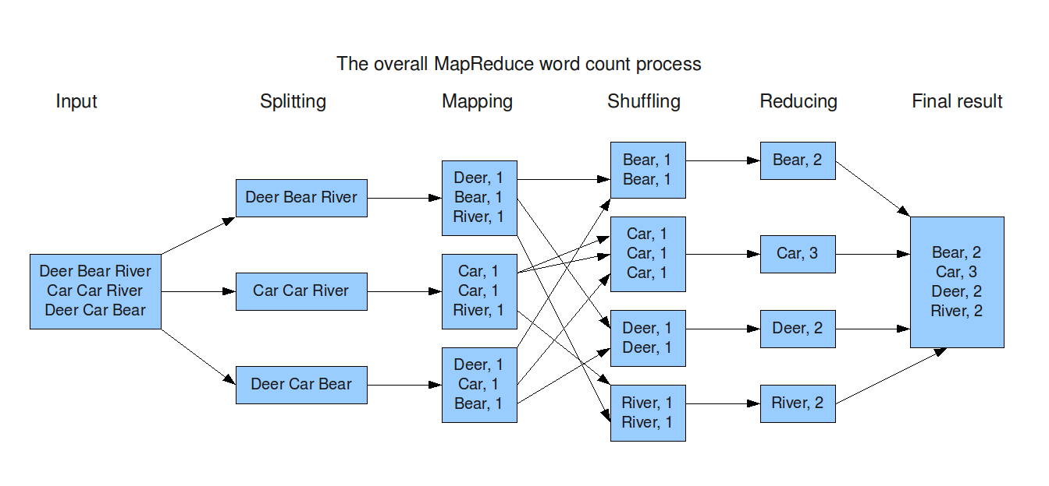
MapReduce Computing Example
WordCount

Slide 29
Hadoop MapReduce
Master node
Jobtracker
Job Submission
⁞
Job 3
Job 2
Job 1
FIFO Queue
Map 1
Map 2
…
Map m
Reduce 1
Reduce 1
…
Reduce n
Map task
Map task
……
Reduce task
Reduce task
Work node 1
(Tasktracker)
Work node 2 (Tasktracker)
Work node K-1 (Tasktracker)
Work node K (Tasktracker)
Hadoop runs a MapReduce.

Slide 30
Hadoop MapReduce
Input Data

Slide 31
MapReduce Program Example
WordCount

Slide 32
MapReduce Program Example
WordCount
Map Function
public static class Map extends MapReduceBase implements Mapper<LongWritable, Text, Text, IntWritable> {
private final static IntWritable one = new IntWritable(1);
private Text word = new Text();
public void map(LongWritable key, Text value, OutputCollector<Text, IntWritable> output, Reporter reporter) throws IOException {
String line = value.toString();
StringTokenizer tokenizer = new StringTokenizer(line);
while (tokenizer.hasMoreTokens()) {
word.set(tokenizer.nextToken());
output.collect(word, one);
}
}
}
Reduce Function
public static class Reduce extends MapReduceBase implements Reducer<Text, IntWritable, Text, IntWritable> {
public void reduce(Text key, Iterator<IntWritable> values, OutputCollector<Text, IntWritable> output, Reporter reporter) throws IOException {
int sum = 0;
while (values.hasNext()) {
sum += values.next().get();
}
output.collect(key, new IntWritable(sum));
}
}

Slide 33
Outline
Introduction to Cloud Computing
Hadoop Data File System (HDFS)
Hadoop MapReduce Framework
Cloud Research Issues
NSC Joint Cloud Project
Conclusions

Slide 34
QoS-Aware Cloud Data Placement
“QoS-Aware Data Replication for Data Intensive Applications in Cloud Computing Systems,” IEEE Transactions on Cloud Computing, Jan.-Jun., 2013.
Hadoop Data Replication
The QoS requirement of a data-intensive application is not taken into account
QoS ⬄ data access time of the applications
Node heterogeneity in the cloud computing system

Slide 35

Data Replication in Hadoop
data replica retrieval time
(4 time units)
QoS violation
expected data access time
(3 time units)
Application
Data block
Notes:
這是一個在HADOOP當中的範例，我們首先說明，在HADOOP當中，資料被切割成幾個資料區塊，分散式的被放置在檔案系統當中，我們可以看出當雲端應用程式要讀取資料時，若發生讀取失敗，或是資料損壞 應用程式無法正常讀取原始區塊，在HADOOP當中 就會選擇讀取該份資料區塊的備份，這一個備份資料我們稱之為副本，這個副本是存放在另外一個儲存節點當中，可以避免當資料無法讀取時，無法達成應用程式讀取or 寫入的 要求

Slide 36
Problem Definition
QoS-aware data replication (QADR) problem
Each data block replica is associated with a QoS requirement in terms of the desired access time.
When data corruption, the node can retrieve the within the desired access time.
The objectives of QADR problem
Minimizing the total replication cost of all data blocks
Minimizing the number of QoS-violated data replicas.
Problem Transformation
QADR problem => MCMF problem
Minimum-Cost Maximum Flow
Well-Known Flow Graph Problem
Optimal solution in polynomial time

Slide 37
Example
QADR Scenario
Request nodes: n₃, n₅, n₇, n₉, n₁₀
(r1) (r2) (r3) (r4) (r5)

Slide 38
Example
Graph Modeling (MCMF Graph)
(Flow capacity, Flow cost)
Flow edge
Flow edge

Slide 39
Example
Optimal solution
Total replication cost = 810

Slide 40
Interference-Aware VM allocation
“Integrating QoS Awareness with Virtualization in Cloud Computing Systems for Delay-Sensitive Applications,” Future Generation Computer Systems
Interference among VMs (VM interference) due to non-sliceable resources (disk I/O, network I/O, etc.)
For two VMs i and j in the same physical machines, the application running on VM i will affect the performance of the application running on VM j.

Slide 41
Non-Sliceable Resource Sharing
Architecture of Xen
Guest domain 3
Guest domain 0
Driver domain
Guest domain 2
Guest domain 1
VM
Xen (hypervisor)
Hardware resources of a physical machine

Slide 42
Problem Definition
Interference-Aware Virtual Machine Placement (IAVMA) problem in cloud computing systems
Reducing VM interference when the VM allocation
Tradition VM allocation
Maximizing the resource utilization of PMs
A variation of knapsack problem
PMs=>knapsacks and VMs=>items
The bin-packing problem is a well-known NP-hard problem
The IAVMA problem is also NP-hard
Proposing a heuristic algorithm

Slide 43
Example
A VM allocation Scenario
Available resource capacities of PMs
PMs | PM1 | PM2 | PM3
CPU compute unit (GHz) | 2 | 7 | 10
Memory space (GB) | 4 | 10 | 16
Storage space (GB) | 400 | 300 | 200
μ(mean service time) | 10 | 9 | 8
σ(variance of service time) | 3 | 2 | 1
Resource demands and rental prices of VMs
VMs | VM1 | VM2 | VM3 | VM4 | VM5
CPU compute unit (GHz) | 1 | 2 | 2 | 4 | 4
Memory space (GB) | 2 | 4 | 8 | 4 | 4
Storage space (GB) | 250 | 250 | 500 | 250 | 250
Rental prices | 70 | 80 | 85 | 90 | 90
QoS | 3 | 2.3 | 2 | 1 | 0.8
I/O request submission rate | 4 | 5 | 6 | 7 | 7

Slide 44
Example
Matching graph establishment
Modeling all the placement relationships between VMs and PMs
matching graph

Slide 45
Solution Comparison
Optimal solution
Total price = 402.2598
Heuristic solution
Total price = 388.402 (↓ 3.44%)
Random solution
Total price = 325.6607 (↓ 32.1%)
Optimal ：Heuristic： Random ＝ 1.00 ：0.97： 0.68

Slide 46
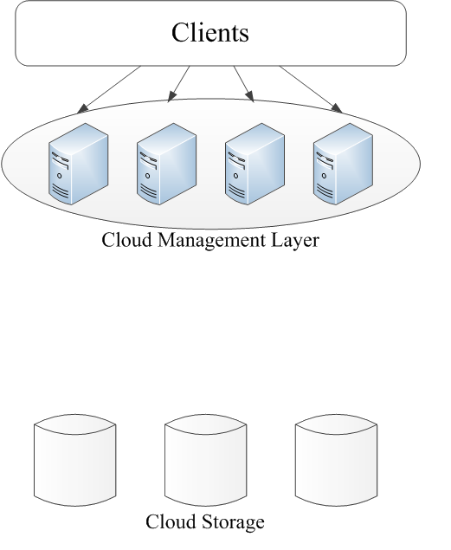

Implementation of Cloud Management
Fault-Tolerant and Load Sharing Cloud Management
Cloud Storage Servers
Uploading and Downloading Files
Notes:
接下來我將介紹我的研究動機，我的研究動機呢，為希望能夠實作出一個能讓使用者不需考慮到儲存空大小能夠輕鬆存取檔案的一個雲端儲存平台，
並希望我們針對伺服器的負載狀況進行改善，來達到提高伺服器整體的負載能力與容錯性，讓使用者感受到伺服器的穩定性

Slide 47
Surveillance Application
Device x 30
2000G(2T) / 30 = 67G
67G / 0.3G = 223h
223h / 24h = 9.3 day
Storage:2TB
Size:
0.2~0.5 GB/1hr
Notes:
而我們希望設計出雲端平台不僅能用於一般的檔案儲存上，也能用於路口監視器的影像儲存，
因一般的路口監視器所能儲存的空間，都有一定的空間限制，就拿儲存空間2TB的硬碟來舉例，
一般的品質的監視器一小時所拍攝的檔案大小，根據錄影品質的設定大約可分為0.2G~0.5G的檔案
那我們拿0.3G品質的檔案來舉例，
如果將2T的硬碟用於儲存30台同款的監視設影機，其檔案大小都是一小時約占0.3G的錄影品質
也就是2T的硬碟，一台監視器約可使用67G的檔案空間
那在將其67G的空間作為換算，大約可錄製223小時
換算成天數大約為9.3天
也就是說2T的硬碟在9.3天至後就必須將較舊的檔案進行刪除，來騰出空間來放置新的檔案
那如果之後需調閱影片的話，就可能已經被刪除了

Slide 48
System Design
Components
Manager Selection
Fault Tolerance
Load Sharing
Authentication
Synchronization
File synchronization
Client side and Cloud side
Cloud-Based File Transfer
Notes:
再來介紹整體程式的架構，而架構可分為四個部分…(介紹4個)

Slide 49
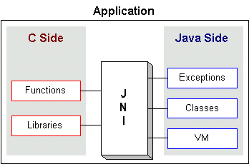
Implementation
Client & Management Layer
C++
Management Layer
Java
Hbase API
C++
HDFS API
JNI (Java Native Interface)

Slide 50
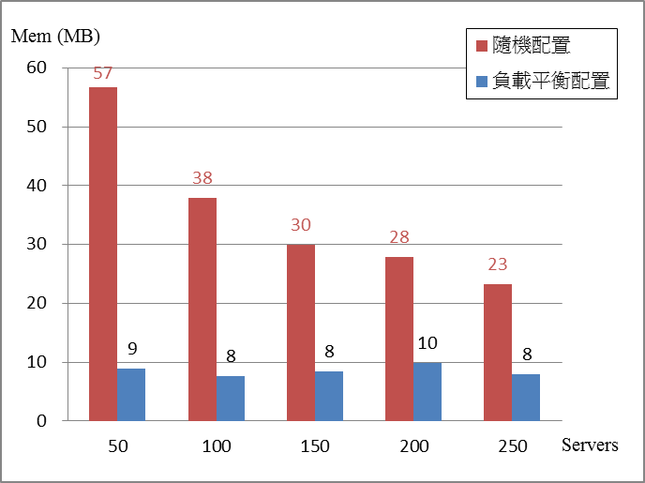
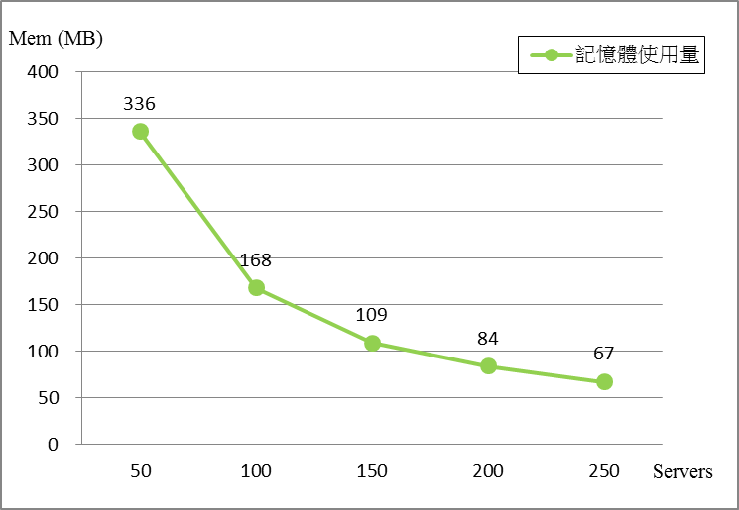
Experiment
Experiment
Servers: 50, 100, 150, 200, 250
Clients : 2000
The mean of memory usage and the variance of memory usage

Slide 51
Outline
Introduction to Cloud Computing
Hadoop Data File System (HDFS)
Hadoop MapReduce Framework
Cloud Research Issues
NSC Joint Cloud Project
Conclusions

Slide 52
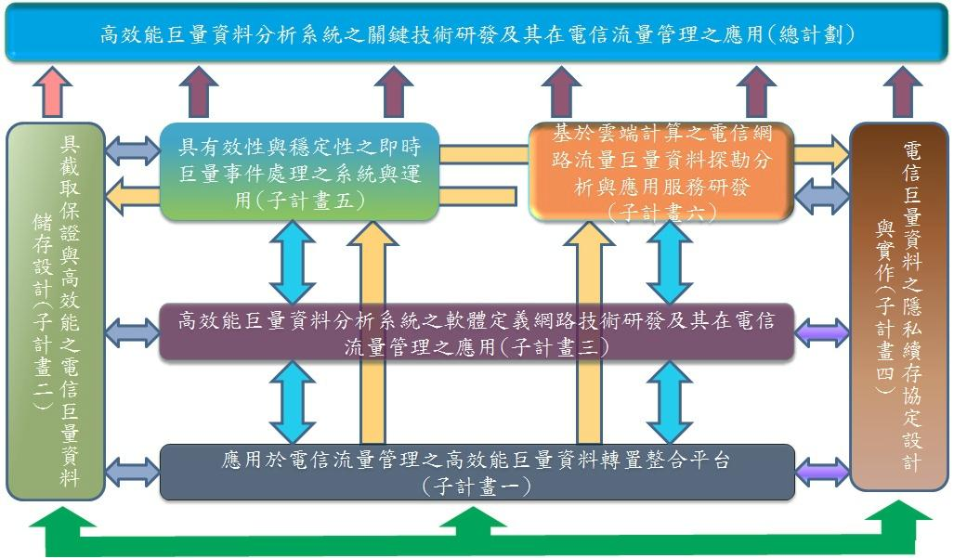
NSC Joint Project

Slide 53
NSC Joint Project
子計畫一：應用於電信流量管理之高效能巨量資料轉置整合平台設計
本子計畫擬建置在資料來源以及分析系統間建立一資料轉置整合平台，用以協助分析系統平台解析各式各樣的系統格式，並產生共用資料模型，進而提供事件服務，使得分析系統平台透過事件服務即可取得需要的資訊。
子計畫二：具擷取保證與高效節能之電信巨量資料儲存設計
本子計畫主要目的在設計巨量電信資料儲存系統，提高電信流量資料檔案在存取與管理的效益。此系統是以Apache Hadoop 平台之檔案系統HDFS (Hadoop Distributed File System) 為基礎 ，增強其在資料擷取、資料管理方面效能、及在電量節能等三方面之功效。
子計畫三：高效能巨量資料分析系統之軟體定義網路技術研發及其在電信流量管理之應用
本子計畫將探討新一代的軟體定義網路(Software-Defined Networking, SDN)架構，藉由將交換器資料層與控制層分離的技術，進一步的將雲端資料中心內的網路也虛擬化。我們將分析巨量資料應用程式所產生的網路流量，可能導致雲端資料中心網路或電信核心網路瓶頸所在，然後利用SDN將網路資源利用最佳化，同時解決網路瓶頸問題。

Slide 54
NSC Joint Project
子計畫四：巨量資料處理之隱私續存協定與安全機制研發及其在電信服務之應用
本子計畫主要在設計密碼學模組供巨料資料來源在其被處理前，對其資料進行前置處理。其中，屬性基底加密法 (Attribute-Based Encryption) 用以實行存取控制。匿名資料探勘 (Anonymous Data Mining)、De-Identification、隱私續存運算 (Privacy-Preserving Computing) 用以保護資料機密性與資料隱私。儲存證明 (Proof of Storage) 用以確保資料完整性；浮水印 (Watermarking) 則用來進行資料所有權之管理。
子計畫五：具有效性與穩定性之即時巨量事件處理系統及其在電信服務管理之應用
本子計畫之研究目的是在關於電信網路中，利用複雜事件處理技術 (complex event processing, CEP) 進行即時巨量資料計算的高可靠度系統與服務品質監控應用。其具體研究內容包含：複雜事件處理引擎之研究、容錯機制設計與複雜事件處理為基礎之服務品質監控應用模式、與事件導向為基礎之服務層級協議應用。
子計畫六：基於雲端計算之電信網路流量巨量資料探勘分析與應用服務研發
本子計畫在巨量電信網路流量資料的基礎上，透過雲端計算系統來進行資料探勘，並且結合行動網路的應用，以建立電信領域的商業智慧，從而研發網路使用行為分析、適地性服務、行動社群網路服務等，進而提升電信網路服務於巨量資料應用上的加值效益。

Slide 55
Outline
Introduction to Cloud Computing
Hadoop Data File System (HDFS)
Hadoop MapReduce Framework
Cloud Research Issues
NSC Joint Cloud Project
Conclusions

Slide 56
Conclusions
Cloud Computing
Hadoop Data File System (HDFS) an MapReduce Framwork
Cloud Research Issues
Ongoing NSC Cloud Project

Slide 57
Thank You for Your Listening

