Slide 1
Lecture 4b
Mobile IPv6

Slide 2
What you will learn in this lecture:
An introduction to IPv6
Differences between Mobile IPv4 and v6.

Slide 3
IPv4 Header (>=20 bytes)
Version (4) | Header Len. (4) | Type of Service (8) | Datagram Length (16)
Identifier (16) |  |  | Flags (3) | Fragmentation Offset (13)
Time-to-Live (8) |  | Upper-layer Protocol (8) | Header Checksum (16)
Source IP Address (32)
Destination IP Address (32)
Options (if any)

Slide 4
IPv6 Header (40 bytes)
Version (4) | Priority (4) | Flow Label (24)
Payload Length (16) |  |  | Next Header (8) | Hop Limit (8)
Source IP Address (128)
Destination IP Address (128)

Slide 5
Number of IP Addresses
In IPv4, there are 2³² – 1, or over 4 billion, addresses.
Q: Is this address space enough?
There is a waste of address space in the traditional two-level addressing scheme.

Slide 6
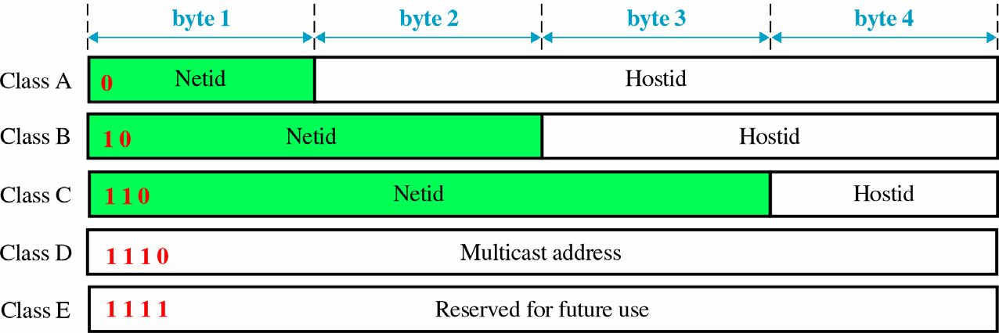
A class C network has only 256 addresses.
If a network has 500 hosts, then a Class B network address (which has 65536 addresses) is needed.
A lot of addresses are wasted.

Slide 7
Expanded Addressing Capabilities
Address size increases from 32 to 128 bits.
  i.e. from 4 bytes to 16 bytes.
Three types of addresses
  Unicast
    A packet is sent to a single destination node.
  Multicast
    A packet is sent to multiple nodes in a multicast group.
  Anycast
    A packet is sent to any one of the nodes assigned that address.
    e.g. an HTTP GET message is sent to any one of the mirror sites that contain a given document.

Slide 8
Version (4) | Header Len. (4) | Type of Service (8) | Datagram Length (16)
Identifier (16) |  |  | Flags (3) | Fragmentation Offset (13)
Time to Live (8) |  | Upper-layer Protocol (8) | Header Checksum (16)
Source IP Address (32)
Destination IP Address (32)
Options (if any)
Version (4) | Priority (4) | Flow Label (24)
Payload Length (16) |  |  | Next Header (8) | Hop Limit (8)
Source IP Address (128)
Destination IP Address (128)

Slide 9
Header Format Simplification
IPv6 header has a fixed length of 40 bytes.
  IPv4 header is at least 20 bytes.
  Header Length field no longer needed.
Fragmentation is not allowed at intermediate routers.
  Identifier, Flags and Fragmentation offset no longer needed.
  Error will be reported to the source if packet is too large.
Header Checksum is removed for fast processing
  Header checksum needed to recompute at every router, since TTL decreases after every hop.

Slide 10
Quality-of-Service Capabilities
Flow Label
– can be used to label packets belonging to a particular traffic flows that needs special handling.

Slide 11
Improved Support for Options
In IPv4,
  Options field is included in the header
  Upper Layer Protocol field points to a higher- layer protocol (e.g. TCP, UDP).
In IPv6
  Options are carried in “extension headers”.
  Next Header field may point to extension headers.

Slide 12
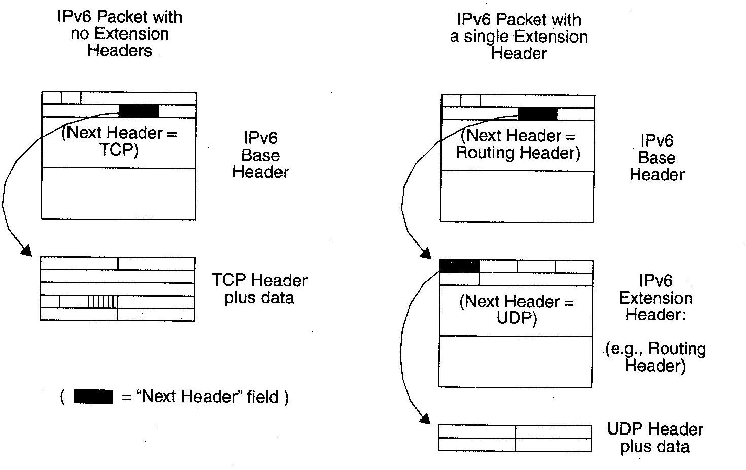
IPv6 Extension Headers

Slide 13
Examples of Extension Headers
Routing Header
  Supports source routing
Authentication Header
  Can be used to support route optimization once a key management infrastructure becomes widely available on the Internet.

Slide 14
Differences between Mobile IPv4 and v6

Slide 15
Mobile IPv6
No Foreign Agent
Route Optimization
– Use both tunneling and source routing to deliver packets to mobile nodes.

Slide 16
No Foreign Agent
The enormous address space allows very simple address autoconfiguration
  a mobile can acquire a collocated care-of address quickly and easily
  foreign agent no longer needed.
Stateless Address Configuration (SAC)
  The idea is to combine the prefix of the network on which it is located with a device identifier, such as its MAC address.

Slide 17
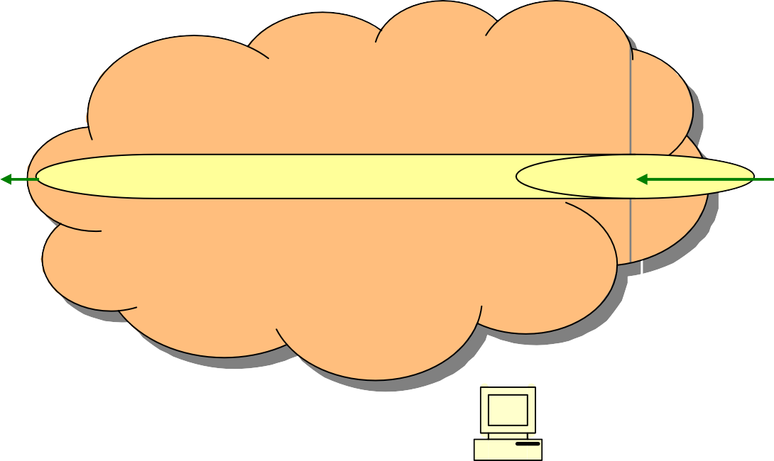
Routing in Mobile IPv6
Correspondent which knows the care-of address
Mobile Node “visiting” a foreign link
Source Routing
Home
Agent
Tunneling
Correspondent which does not know the care-of address

Slide 18
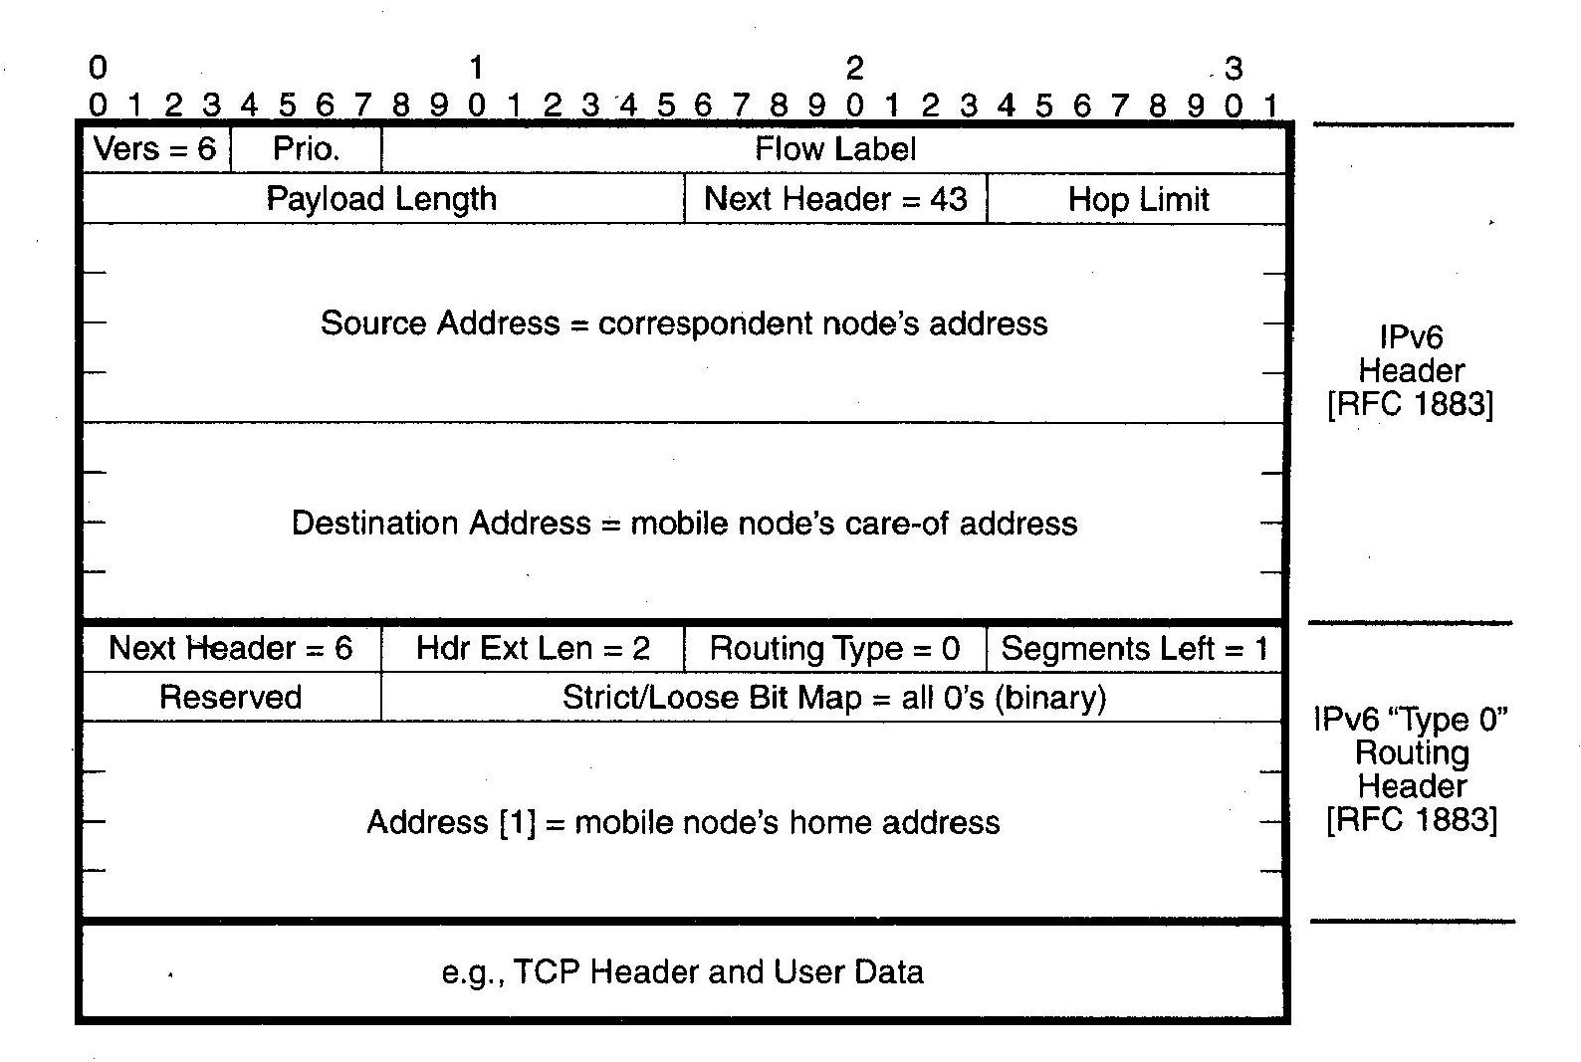
Source-Routed Packet

Slide 19
References
J. F. Kurose and K. W. Ross, Computer networking: a top- down approach featuring the Internet, Addison Wesley, 2001.
J. D. Solomon, Mobile IP: the Internet unplugged, Prentice Hall, 1998.
C. E. Perkins, “Mobile networking through mobile IP,”
IEEE Internet Computing, pp. 58-69, Jan/Feb, 1998.

