Slide 1
系 統 程 式
System Programming

Slide 2
BACKGROUND
1/3
What is system software ?
Major topics about system software:
Assemblers, Loader and Linkers, macroprocessors, compilers operating systems, database management systems, text editors, interactive debugging systems.
What is the difference between AP and SP ?
It is machine dependency.

Slide 3
BACKGROUND
2/3
Each system software is described by the following functions:
fundamental features
machine-independent features (3)machine-dependent features (4)Major design idea
(5)Example of implementations

Slide 4
BACKGROUND
3/3
5. Simplified Instructional Computer (SIC), SIC/XE (with extra equipment)
(1)memory (2)registers (3)data formats
(4)Instruction formats (5)addressing mode

Slide 5
SIC machine architecture 1/2
Memory
8-bit byte, 24-bit word, 32k memory size(=2¹⁵)
Instruction format
8 1 15
Data format
Integer: 24-bit binary numbers
(2’s complement for negative).
Character: 8-bit ASCII codes.
opcode | x | address

Slide 6
SIC machine architecture 2/2
Addressing mode
Direct : X=0, target address = address Indexed : X=1, target address = address +(X)
Register
A: accumulator X: index register
L: linkage register
PC : program counter SW : status word

Slide 7
SIC/XE machine architecture 1/5
(1)Memery
1 M memory Size (=2²⁰) (2)Instruction format
8
opcode
8 4 |  | 4
opccode | register | register
6 1 1 1 1 1 1 |  |  | 12
6 1 1 1 1 1 1 |  |  |  | 20
opcode | n | i | x | b | p | e | displacement
opcode | n | i | x | b | p | e | displacement

Slide 8
SIC/XE machine architecture 2/5
(3)Data format
Floating-point : 1 11
36
s | exponent | fraction

Slide 9
SIC/XE machine architecture 3/5
(4)Addressing mode Program-counter relative : b=0, p=1,
TA=(PC) + disp (-2048<=disp<=2047)
Base relative :
b=1, p=0, TA=(B) + disp (0<=disp<=4095)
Direct :
i=0, n=0, TA=(disp or addr) Index :
X=1

Slide 10
SIC/XE machine architecture 4/5
Immediate :
i=1, n=0, operand=disp Indirect :
i=0, n=1, TA’=(TA)
Extended :
i=1, n=1, e=1, TA=addr

Slide 11
SIC/XE machine architecture 5/5
(5)Register
B : base register
S : general working register T : general working register
F : floating-point accumulator (48-bit)

Slide 12
CPU
Memory
ALU
CU
instruction
Data
PC
( P C )
ACC
Data
IR
(LDA)
Decoder
( T A )
I / O

Slide 13
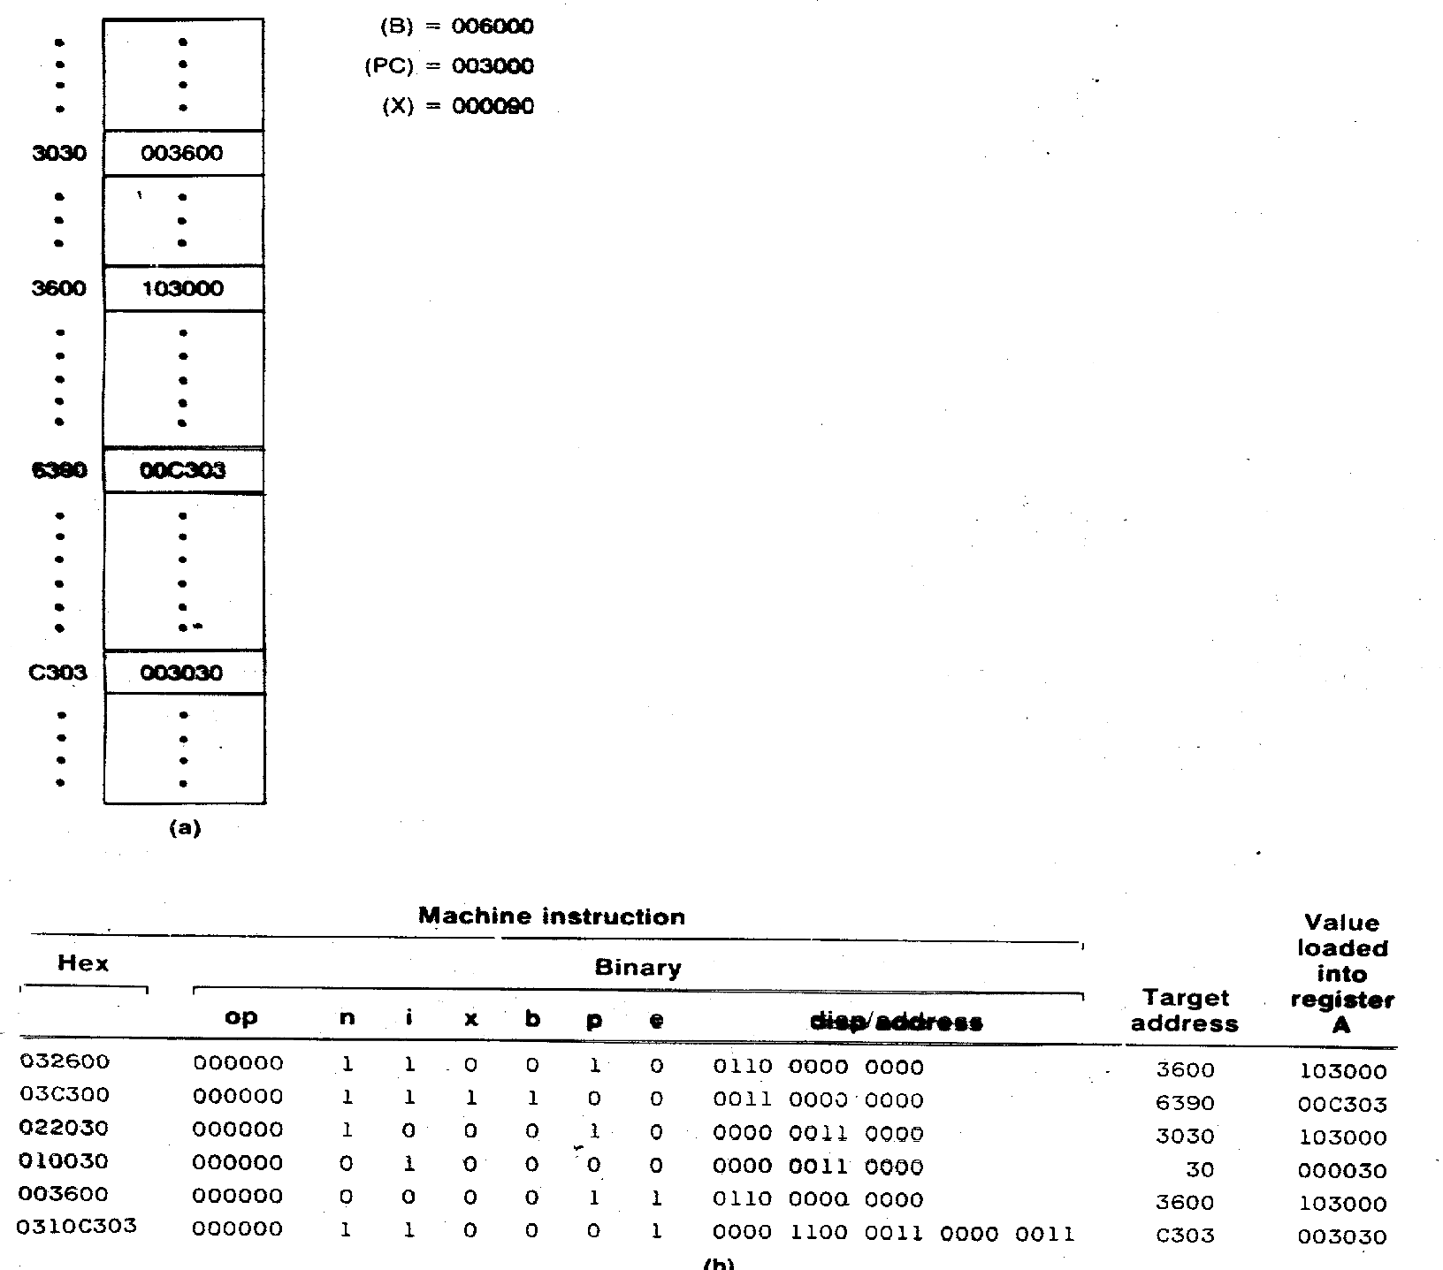
LDA

Slide 14
Machine instruction
Hex
Binary
op
n i x b p e
disp/address
(1)032600 000000
1 1 0 0 1 0 0110 0000 0000
LDA:load address SIC/XE pc:program counter
Target address : 003000(program counter)+ 6 0 0
= 3 6 0 0
Value loaded into register A: 103000
·
·
103000
·
p11. figure(a) : 3600 000000 110010 0110 0000 0000 ·
Hex: 0 3 2 6 0 0

Slide 15
Target address : 000090(index register)
Hex | op | n i | x b p e | disp/address
(2)03C300 | 000000 | 1 1 | 1 1 0 0 | 0011 0000 0000
LDA:load address SIC/XE index base
+ 3 0 0
006000(base register)
= 6 3 9 0
Value loaded into register A: 00C303
·
·
p11. figure(a) : 6390
·
·
· ·
00C303
· ·
000000 111100 0011 0000 0000
Hex: 0 3 C 3 0 0

Slide 16
Hex op
(3)022030 000000
n i x b p e
1 0 0 0 1 0 0000 0011 0000
indirect pc
disp/address
Target address : 003000(program counter) + 0 3 0
= 3 0 3 0
load address:3 6 0 0 · ·
Value loaded into register A: 103000 3030 003600
· ·
· ·
3600 103000
·
·
(indirect address)
p11. figure(a) :
·
·
000000 100010 0000 0011 0000
Hex: 0 2 2 0 3 0

Slide 17
Hex | op | n | i x | b | p | e | disp/address
(4)010030 | 000000 0 1 0 0 immediate |  |  |  | 0 | 0 | 0000 0011 0000
Target address :
= 3 0
Value loaded into register A: 000030
+ 0
3 0
000000 010000 0000 0011 0000
Hex : 0 1 0 0 3 0

Slide 18
n i x b p e
0 0 0 0 1 1 0110 0000 0000
Hex
op
disp/address
(5)003600 000000
SIC(direct)
Target address : (direct address) 3
6 0 0
Value loaded into register A: 103000
·
p11. figure(a) : 3600
·
000000 000011 0110 0000 0000
Hex: 0 0 3 6 0 0
·
103000
·

Slide 19
(6) Hex op n i x b p e 0310C303 000000 1 1 0 0 0 1
disp/address
0000 1100 0011 0000 0011
SIC/XE
extended
0 C 3 0 3
Target address :
·
·
p11. figure(a) : C303
·
Value loaded into register A: 003030
· ·
003030
·
000000 110001 0000 1100 0011 0000 0011
3 1 0 C 3 0 3
Hex:0

Slide 20
Sample data movement operations for (a)SIC and (b)SIC/XE
LDA FIVE
STA ALPHA
LDCH CHARZ
STCH C1
.
ALPHA | RESW | 1
FIVE | WORD | 5
CHARZ | BYTE | C ’ Z ’
C1 | RESB | 1
LDA STA LDA STCH
.
# 5
ALPHA # 90
C1
ALPHA | RESW | 1
C1 | RESB | 1

Slide 21
Sample data movement operations for (a)SIC
CPU
MEMORY
(word)
A:
Z
5
(ACC)
FIVE:
5
ALPHA:
5
(byte)
CHARZ:
Z
C1:
Z
(Z:character)
LDA
FIVE
STA ALPHA
LDCH CHARZ
STCH C1
.
ALPHA
FIVE
CHARZ C1
RESW 1
WORD 5
BYTE C ’ Z ’
RESB 1

Slide 22
Sample data movement operations for (b)SIC/XE
CPU MEMORY
A: 90 (ACC)
(word)
ALPHA: 5
(byte)
5
C1:
90->5A (ASCII CODE) =Z
LDA
# 5
STA ALPHA
LDA # 90
STCH C1
.
ALPHA C1
RESW 1
RESB 1

Slide 23
Sample arithmetic operations for (a)SIC and (b)SIC/XE
 | LDA ADD SUB STA LDA ADD SUB STA | ALPHA INCR ONE BETA GAMMA INCR ONE DELTA
 | . .
ONE | WORD | 1
.
ALPHA | RESW | 1
BETA | RESW | 1
GAMMA | RESW | 1
DELTA | RESW | 1
INCR | RESW | 1
BETA←ALPHA+INCR-ONE
DELTA←GAMMA+INCR-ONE
1/2

Slide 24
Sample arithmetic operations for (a)SIC and (b)SIC/XE
 | LDS | INCR
 | LDA | ALPHA
 | ADDR SUB | S , A # 1
 | STA | BETA
 | LDA ADDR | GAMMA S , A
 | SUB STA | # 1 DELTA
 | .
 | .
ALPHA | RESW | 1
BETA | RESW | 1
GAMMA | RESW | 1
DELTA | RESW | 1
INCR | RESW | 1
2/2

Slide 25
Sample looping and indexing operation for (a)SIC,(b)SIC/X
 | LDX | ZERO
MOVECH | LDCH | STR1 , X
 | STCH TIX | STR2 , X ELEVEN
 | JLT . | MOVECH
 | .
 | .
STR1 | BYTE | C ‘ TEST STRING ‘
STR2 | RESB | 11
.
. ZERO
ELEVEN
WORD 0
WORD 11
(a)
1/2

Slide 26
Sample looping and indexing operations for (a)SIC
MEMORY
(word) ZERO:
CPU
X:
0 ->1
0
( t(es1t X<=111,E)LEVEN=11 )
0
PC
MOVECH
ELEVEN:
11
ACC
T
(byte)
STR1: STR2:
T | E | S | T |  | S | T | R | I | N | G
Status word:
<
T
LDX ZERO
MOVECH
LDCH
STR1 , X
STCH STR2 , X TIX ELEVEN
JLT MOVECH
.
STR1
BYTE
C ’ TEST STRING ‘
STR2
.
ZERO ELEVEN
RESB 11
WORD 0
WORD 11

Slide 27
Sample looping and indexing operation for (a)SIC,(b)SIC/X
 | LDT | # 11
 | LDX | # 0
MOVECH | LDCH STCH | STR1 , X STR2 , X
 | TIXR | T
 | JLT . | MOVECH
 | . .
STR1 | BYTE | C ’ TEST STRING ‘
STR2 | RESB | 11
(b)
2/2

Slide 28
Sample looping and indexing operations for (b)SIC/XE
CPU MEMORY
X:
0 ->1
0
(₍te₁xt <X=₁₁ ,₎T= 11 )
T:
11
PC
MOVECH
(byte)
T
STR1: STR2:
T | E | S | T |  | S | T | R | I | N | G
ACC
Status word:
<
T
LDT #11
LDX #0
LDCH STR1 , X
STCH STR2 , X TIXR T
JLT MOVECH
.
BYTE RESB
MOVECH
STR1 STR2
C ’ TEST STRING ‘
11

Slide 29
Sample indexing and looping operation for (a)SIC,(b)SIC/X
LDA STA
ZERO INDEX
ADDLP | LDX | INDEX
 | LDA | ALPHA , X
 | ADD | BETA , X
 | STA | GAMMA , X
 | LDA | INDEX
 | ADD | THREE
 | STA | INDEX
 | COMP | K300
 | JLT | ADDLP
 | .
INDEX | RESW | 1
.
ALPHA | RESW | 100
BETA | RESW | 100
GAMMA | RESW | 100
.
ZERO | WORD | 0
K300 | WORD | 300
1/2
(a)

Slide 30
Sample indexing and looping operation for (a)SIC,(b)SIC/X
 | LDS | # 3
 | LDT | # 300
ADDLP | LDX LDA | # 0 ALPHA , X
 | ADD | BETA, X
 | STA ADDR | GAMMA, X S , X
 | COMPR JLT | X , T ADDLP
 | . .
ALPHA | RESW | 100
BETA | RESW | 100
GAMMA | RESW | 100
(b)
2/2

Slide 31
Sample input and output operations for SIC
INLOOP
pooling busy waiting
ACC←INPUT ACC→DATA
TD JEQ RD STCH
.
.
.
TD OUTDEV
JEQ OUTLP
LDCH DATA ACC←DATA
WD OUTDEV ACC→OUTPUT
.
.
. BYTE BYTE RESB
INDEV INLOOP INDEV DATA
OUTLP
INDEV OUTDEV DATA
X ‘ F1 ‘
X ‘ 05 ‘
1

Slide 32
Sample subroutine call and record input operations for(a)SIC (b) SIC/XE
 | JSUB | READ
 | .
 | .
READ | LDX | ZERO
RLOOP | TD | INDEV
 | JEQ | RLOOP
 | RD | INDEV
STCH TIX JLT RSUB
.
. BYTE
RECORD , X K100 RLOOP
RECORD
 |  |  | …
X=1 =2
… 100
INDEV
X ‘ F1 ‘
RECORD | RESB | 100
.
ZERO | WORD | 0
K100 | WORD | 100
(a)
1/2

Slide 33
Sample subroutine call and record input operations for(a)SIC (b) SIC/XE
JSUB
.
.
READ
READ | LDX | # 0
 | LDT | # 100
RLOOP | TD | INDEV
 | JEQ | RLOOP
 | STCH | RECORD , X
 | TIXR | T
 | JLT | RLOOP
 | RSUB
 | .
 | .
INDEV | BYTE | X ’ F1 ‘
RECORD | RESB | 100
(b)
2/2

